Slide 1






EU – JAPAN EPA:
What’s in for the AGRI-FOOD Sector?
Managed by
www.eu-japan.eu/epa-helpdesk
Under the supervision of

Slide 2
EPA Process
INCREASE MARKET SHARE
EU PRODUCTS
PROMOTION &
INFORMATION
July 2018
Signature
1/2/2019
Entry into Force
Managed by
www.eu-japan.eu/epa-helpdesk
Under the supervision of

Slide 3
Managed by
www.eu-japan.eu/epa-helpdesk
Under the supervision of

Slide 4
SMEs
Source: Eurostat
Managed by
www.eu-japan.eu/epa-helpdesk
Under the supervision of

Slide 5
MARKET ACCESS
Types of EPA Concessions
Type | EPA Code | Description
Immediate Liberalisation | A | Japan’s base rate is eliminated at the entry into force of the Agreement Most of those tariff lines are not listed in Japan’s EPA tariff schedule
Duty elimination spread over a period | B | Gradual elimination of Japan’s base rate over a period of time. the zero duty will be applied in subsequent years.
Duty reduction spread over a period | R | Gradual reduction of Japan’s base rate to a certain level. The final reduced level will be applied in subsequent years.
Tariff rate quotas | TRQ | TRQs allow for one of the above preferences within the limits of an annual import quantity.
Exclusion | X | Tariff lines excluded from any preference
Managed by
www.eu-japan.eu/epa-helpdesk
Under the supervision of

Slide 6
A few highlights of what’s the EPA
is offering
Product | EPA Concession
Wine | Free trade
Meat Products | Beef: duties will be drastically reduced from 38% to 9% over 15 years Pork: elimination or significant tariff reduction over 10 years
Fruit & Vegetables (Fresh & Prepared) | Free trade at the entry into force of the EPA or duties phased out in max. 10 years
Biscuits and waffles | Duties phased out over periods between 5 to 8 years
Olive oil | Free trade
Hard cheese | Duty phasing out in 15 years
Other cheeses | Duty free TRQ of 20.000t to 31.000t
Chocolates | For most of the products: duty phasing out in 10 years | For some products duty elimination or duty reduction within TRQs
Pasta | For most of the products: duty phasing out in 10 years
Fish & Fish Products | Duty free or duties phased out over periods between 5 and 10 years
Managed by
www.eu-japan.eu/epa-helpdesk
Under the supervision of

Slide 7
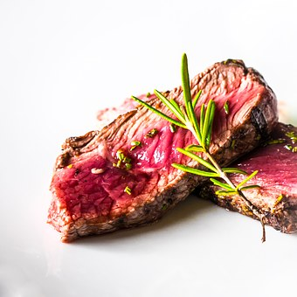
BEEF
  Drastic tariff reduction: from 38.5% to 9% in 15 years.
  High safeguard trigger (50.500 t after 10 years) which may disappear on the long run.
  Gradual increase of EU exports after long lasting BSE ban …
Managed by
www.eu-japan.eu/epa-helpdesk
Under the supervision of

Slide 8
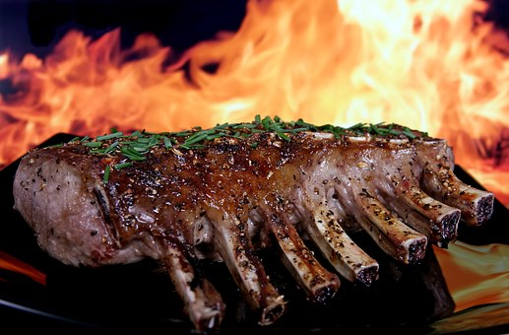
PIGMEAT
  EU most important agri export : 1.2 bn€ > 30% of import market share.
            Meat fresh, chilled and frozen: almost tariff elimination (specific duty divided by 10!)
            Sausages and pork preparations: full tariff elimination in 5 years
  Temporary safeguard (10 years) – low snapback duty
  MFN safeguard not applicable to EU products
Managed by
www.eu-japan.eu/epa-helpdesk
Under the supervision of

Slide 9

CHEESES
Hard cheeses: duty free in 15 years
Soft and processed cheeses: duty free TRQ
Continued growth based on
cheese consumption
growth in Japan
1/4/2019
20.600 t
1/4/2033
31.000 t
Managed by
www.eu-japan.eu/epa-helpdesk
Under the supervision of

Slide 10
OTHER DAIRY
Whey products:
  Drastic tariff reductions or almost tariff elimination over time with transitional TRQs, depending on mineral and protein content, etc.
Skimmed milk powder (SMP):
  Important TRQ together with butter
  To note: SMP for feeding: 95% tariff reduction
Lactose: duty elimination
Ice cream: important duty reduction
Managed by
www.eu-japan.eu/epa-helpdesk
Under the supervision of

Slide 11


WINES
Wine sector: > € 800 million / 13% of EU total agri exports to Japan.
EPA: duty free for EU wines since1 February 2019 → level playing field with Chili and Australia
Facilitation for EU oenological practices
GI protection of more than 100 EU wine names
Managed by
www.eu-japan.eu/epa-helpdesk
Under the supervision of

Slide 12

SPIRITS & BEERS
Already MFN duty free for all beers and most of the spirits
Remaining duties for spirits eliminated since 1 Feb 2019 (gin, Genever, vodka, etc.).
GI protection for 28 spirits and 6 beers
Managed by
www.eu-japan.eu/epa-helpdesk
Under the supervision of

Slide 13
FRUIT & VEGETABLES
FRESH
A few products will be liberalised in max. 10 years.
  Onions (5yrs), sweetcorn (3yrs), sweet potatoes (5yrs), nuts (5 or 10yrs), bananas (10yrs), apples (10yrs), oranges (5 or 10yrs), cherries (5yrs).
Most of the fresh fruit and vegetables were liberalised upon the EIF of the Agreement
Managed by
www.eu-japan.eu/epa-helpdesk
Under the supervision of

Slide 14
FRUIT & VEGETABLES
PROCESSED
Main products not liberalised at EIF but at a later stage:
not roasted ground nuts: 5 to 7 yrs.
sweet-corn prepared or preserved by vinegar: 5 yrs.
tomatoes prepared, other than whole or in pieces: 5 yrs.
French mushrooms: 5 yrs.
frozen cooked potatoes: 3 yrs – frozen mashed potatoes: 5 yrs.
jams of citrus fruit with added sugar: 5 yrs.
juices:
  citrus: 5 or 10 yrs.
  tomato: 5 yrs.
  apple: 7 or 10 yrs.
  mixtures: 3, 5 or 10 yrs.
Same scenario:
Most of the processed fresh fruit and vegetables were liberalised upon the EIF of the Agreement
Managed by
www.eu-japan.eu/epa-helpdesk
Under the supervision of

Slide 15
VEGETABLE OILS
A number of vegetable oils (including olive oil , palm oil, coconut oil, palm kernel oil) are duty free (MFN or EPA)
Others will have duties phased out in:
  5 years, including soya bean oil, sunflower seed oil, rape and colza oil;
  10 years, including ground nut oil and maize (corn) oil.
Managed by
www.eu-japan.eu/epa-helpdesk
Under the supervision of
Notes:
READ SLIDE

Slide 16
Cereals Based Products
Most important products:
Label | Preference
Biscuits, cookies, pastry cakes, bread, breakfast cereals, rusks, waffles, uncooked pasta, pizza, uncooked macaroni, malt extract, couscous | Gradual duty elimination within 5 to 10 years
Mixes and doughs and cake mixes | Duty free within a TRQ of max. 14.200t on 1/4/2023
Food preparations made primarily of wheat | Duty free within a TRQ of max. 3.000t on 1/4/2023
Food preparations containing more than 50% sucrose, and coca powder | Duties gradually reduced by 50% by 1/4/2028 within a TRQ of max. 130t
Managed by
www.eu-japan.eu/epa-helpdesk
Under the supervision of

Slide 17
OTHER PROCESSED AGRI PRODUCTS
Duty free since1 February 2019 for:
egg albumin, mineral waters, preserved tomatoes, pure cocoa powder, pectic substances, yeasts, caseinates
Duty free 01/02/2019
  Wheat related food preparations and barley, wheat flours etc.: Sizeable TRQs
Managed by
www.eu-japan.eu/epa-helpdesk
Under the supervision of

Slide 18

OTHER PROCESSED AGRI PRODUCTS
Duty free in maximum 10 years for:
Spaghetti, pastries, waffles, breakfast cereals, biscuits,
Chocolates and choc. confectionary
Candies and sugar confectionary,
Tomato puree,
Several food preparations,
Esterified starches
Max 10 years
Managed by
www.eu-japan.eu/epa-helpdesk
Under the supervision of

Slide 19
A few Remaining Agri Products …
Product | EPA Concession
Coffee | Duty free
Juices | Duty phasing out over periods between 3 to 10 years Citrus: 5 or 10 years; Apple: 7 to 10 years; Mixed: 3, 5 or 10 years; Tomato: 5 years
Jams & Jellies | Duty phasing out over periods between 3 to 10 years Citrus: 5 to 10 years; Other: Jams: duty free – Jellies: 5 years
Starches | Esterified starches: duty free as from 1/4/2023 Dextrins and other modified starches & glues: duties phased out in 10 years
Extracts & essences of coffee | Containing added sugar: duty reduction from 24% to 9.6% in 6 years Other: duty free
Managed by
www.eu-japan.eu/epa-helpdesk
Under the supervision of

Slide 20
FISHERY PRODUCTS
All fishery products CH03, CH1504 and CH16:
  were already duty free at MFN level, or
  have been liberalised as an EPA concession at the EIF, or
  will be gradually liberalised as an EPA concession in max. 15 years.
  exception: whale oil (150430.010): excluded.
A few examples …
A few examples of EU fishery products exported to Japan:
Jap. Code | Label | Base Rate MFN | Pref. Rate 1/4/20 -31/3/21 | EPA Preference
030235.010 | Fresh or chilled Atlantic bluefin tunas | 3.5% | 1.8% | Base rate phased out in 5 years
030235.020 | Fresh or chilled Pacific bluefin tunas | 3.5% | 2.5% | Base rate phased out in 10 years
030487.050 | Frozen yellowfin bigeye tunas | 3.5% | 0% | Duty free since EIF
030214.000 | Fresh or chilled Atlantic salmon | 3.5% | 0% | Duty free since EIF
160300.090 | Extracts and juices of fish or crustaceans | 9.6% | 0% | Duty free since EIF
Managed by
www.eu-japan.eu/epa-helpdesk
Under the supervision of

Slide 21

GEOGRAPHICAL INDICATIONS
Full protection for 210 EU GIs (wines, spirits and food-stuffs):
Direct protection of GIs under the EPA.
Relation between GIs and Trade Marks (TMs):
  no registration in Japan of subsequent TMs;
  coexistence with pre-existing TMs is addressed.
Listed prior uses to expire within 5 or 7 years
Possibility to add new GIs in the future.
A few examples of protected Spanish GIs:
    Wine: Cataluna, Cava, La Mancha, Rioja, …
    Spirits: Brandy de Jerez
    Meat: Jamon de Teruel/Paleta de Teruel, …
    Oils & Fats: Sierra de Segura, Sierra Magina, …
Managed by
www.eu-japan.eu/epa-helpdesk
Under the supervision of

Slide 22
RULES OF ORIGIN
GENERALITIES
to benefit from an EPA preference: product must be originating in the EU or Japan.
to be originating the product must comply with:
  the provisions “Rules of Origin” of the EPA text (Chapter 3), including the basic requirements to originating, and
  the Product Specific Rules (PSR) for each product (Annexes 3A/3B and Appendix 3-B-1): further requirements in order to be originating.
    These requirements can include:
    a change in tariff classification
    a production process
    a maximum value of non-originating materials
    a minimum regional value content
Managed by
www.eu-japan.eu/epa-helpdesk
Under the supervision of

Slide 23
RULES OF ORIGIN
A FEW EXAMPLES …
HS CODE | LABEL | PSR | COMMENTS
Chapter 08 | Edible fruit | Wholly obtained | Products must be of EU/Japan origin
Heading 20.01 | Prepared fruit and vegetables | CC | Non-EU/Japan originating materials may be used in the production of the goods if these materials are classified under another Chapter
Heading 1806 | Chocolates and other cocoa preparations | CTH, provided that: the total weight of the non-originating materials of CH4 (dairy) and of Heading 19.01 (food preparations) used does not exceed 10% of the weight of the product; and the total weight of the non-originating materials of Headings 17.01 (cane or beet sugar) and 17.02 (other sugars) used does not exceed 30% of the weight of the product; | Non-EU/Japan originating materials may be used in the production of the goods if these materials are classified under another Heading, and the 2 conditions are satisfied.
Managed by
www.eu-japan.eu/epa-helpdesk
Under the supervision of
Notes:
READ SLIDE

Slide 24

INFORMATION SOURCES
EPA text and Annexes: http://trade.ec.europa.eu/doclib/press/index.cfm?id=1684
Of which:
    Annex 2-A: Schedule and Notes (TRQ, etc);
    Annex 2-E: Facilitation of wine export;
    Annex 3-B: Product specific rules of origin;
    Annex 14-B: GIs.
Managed by
www.eu-japan.eu/epa-helpdesk
Under the supervision of

Slide 25
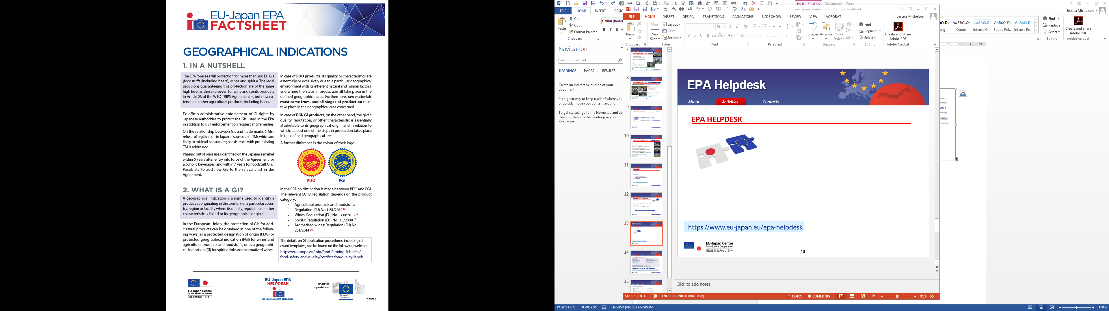
INFORMATION SOURCES
EPA Helpdesk: https://www.eu-japan.eu/epa-helpdesk
            Fiches per sectors and webinars on EPA outcome
9 April 2019 | Wines and Spirits
7 May 2019 | Geographical Indications
21 May 2019 | Dairy Products
11 June 2019 | Meat Products
18 June 2019 | Processed Agricultural Products
Managed by
www.eu-japan.eu/epa-helpdesk
Under the supervision of

Slide 26
INFORMATION SOURCES
Overall import conditions in Japan:
  European Commission DG TRADE “Market Access Database”: http://madb.europa.eu/madb/indexPubli.htm
  European Commission DG AGRI “Food and Beverage Handbook – Japan”:
  https://ec.europa.eu/chafea/agri/content/food-and-beverage-market-entry-handbook-japan
Japan’s Customs:
http://www.customs.go.jp/english/c-answer_e/imtsukan/1524_e.htm
Managed by
www.eu-japan.eu/epa-helpdesk
Under the supervision of

Slide 27
INFORMATION SOURCES
European Commission (DG TAXUD) – Rules of Origin:
  https://ec.europa.eu/taxation_customs/business/calculation-customs-duties/rules-origin_en
  https://ec.europa.eu/taxation_customs/business/international-affairs/international-customs-cooperation-mutual-administrative-assistance-agreements/japan_en
  https://ec.europa.eu/taxation_customs/sites/taxation/files/eu_japan_epa_guidance_claim_verification_denial_en.pdf
European Commission: Geographical Indications
  https://ec.europa.eu/info/food-farming-fisheries/food-safety-and-quality/certification/quality-labels
Managed by
www.eu-japan.eu/epa-helpdesk
Under the supervision of

Slide 28
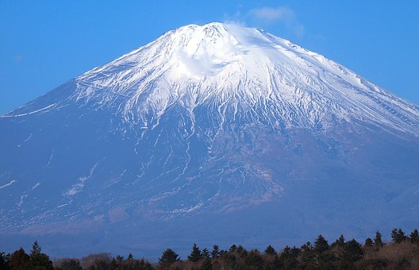

Thank you for your attention
Yvan Van EESBEEK
Consultant at the EU-Japan Centre for Industrial Cooperation
Questions ?
This presentation has been prepared with the sole purpose of simplifying the understanding of some parts of the EU-Japan EPA and bears no legal standing.

