Slide 1
Government procurement in Japan
Topic 1
Topic 2
Topic 3
Topic 4
Contact
Government procurement in Japan
Session 1:
General features
Lyckle Griek
Japan Tax & Public Procurement Helpdesk
eu-japan.eu

Slide 2
Government procurement in Japan
Topic 1
Topic 2
Topic 3
Topic 4
Contact
Training of three modules
Module 1: General Features
Module 2: Procedures, eligibility & assessment, standards & legal issues
Module 3: Overview of public sector lighting market & building partnerships
eu-japan.eu

Slide 3
Module 1: General Features
Today’s Module
Government procurement market: distinctions to keep in mind
Types of public procurement procedures
Finding tender information
The tender notice explained
Challenges for foreign suppliers
eu-japan.eu

Slide 4
Module 1: General Features
Some terms to keep in mind
Japanese | Pronunciation | English
政府調達 公共調達 | Seifu chōtatsu Kōkyō chōtatsu | Government procurement Public procurement
入札情報 | Nyūsatsu jōhō | Tender information
契約 | keiyaku | contract
eu-japan.eu

Slide 5
GP market: Distinctions
EPA!!!
(Since Feb. 1, 2019)
Topic 1
Topic 2
Topic 3
Topic 4
Contact
Domestic
tenders
Ministries
National agencies
Government corporations (WTO Annex 3)
Ministries
National agencies
Government corporations (WTO Annex 3)
Central government
>€120,000
>€5.4 mln
47 Prefectures (and local offices)
Organizations under their jurisdiction
20 “Designated cities (Including Tokyo)
54 “Core Cities”
Procurement related to production, transport or distribution of electricity
47 Prefectures (and local offices)
Organizations under their jurisdiction
19 “Designated cities (Including Tokyo)
WTO regulated tenders
Approx. 35%
Sub-central government
Equal treatment
Longer lead times
English summaries
Some organizations are excluded
Some products/services are excluded
>€240,000
>€18.3 mln
Local government
Local rules
Short lead times
Japanese only
eu-japan.eu

Slide 6
Types of tender procedures
Topic 1
Topic 2
Topic 3
Topic 4
Contact
Compatibility (ICT)
Open competitive procedures
(ippan kyōsō nyūsatsu)
Designated/
selective tender procedures (domestic)
(shimei kyoso nyusatsu)
Single tender procedures
(zui keiyaku)
Designated/
selective tender procedures
(shimei kyoso nyusatsu)
Common Rare
Variations:
Public Offers (Koubo-kei)
Plan competitions (propozaru-hōshiki)
Small-amount procurement:
“Open counter”
(Invoice-based)
eu-japan.eu

Slide 7
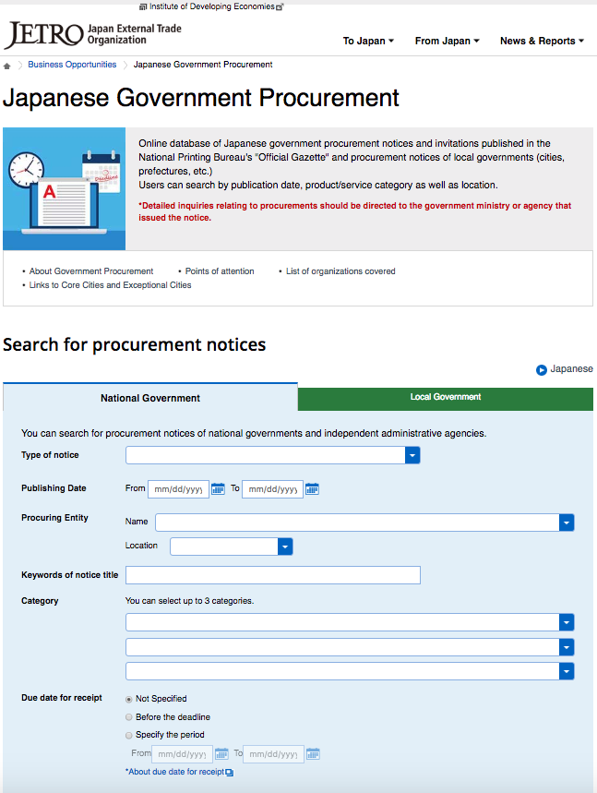
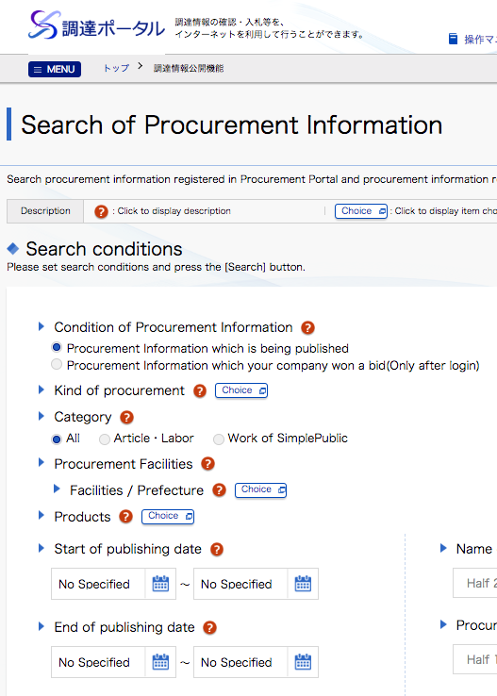
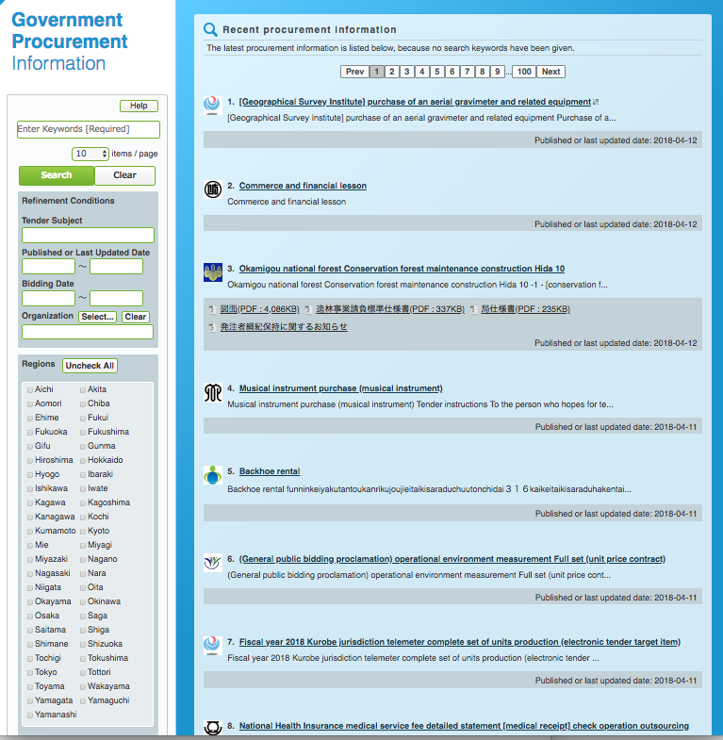
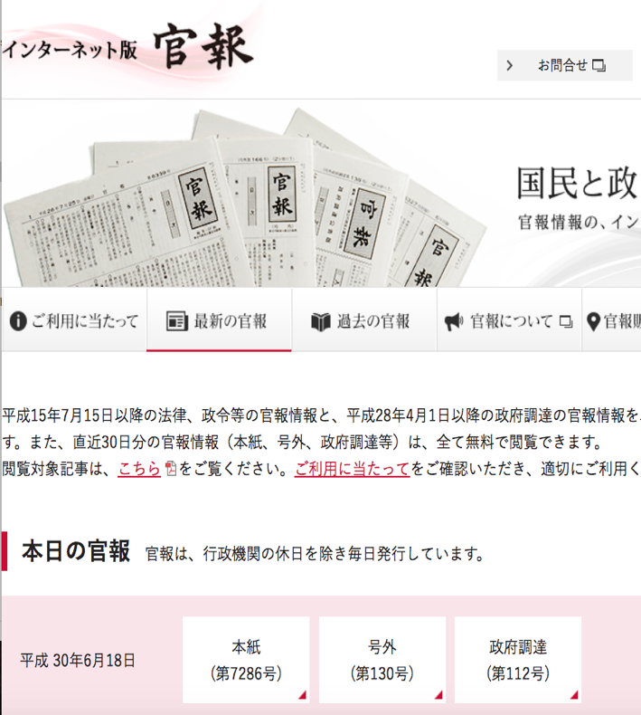
Finding tender information
English-language notices (WTO/EPA):
Japan External Trade Organisation (JETRO)
EU-Japan Centre for Industrial Cooperation
Chotatsu portal
Government Gazette website
Tokyo Metropolitan Government
Individual entities (NTT, Tokyo Metro)
eu-japan.eu

Slide 8
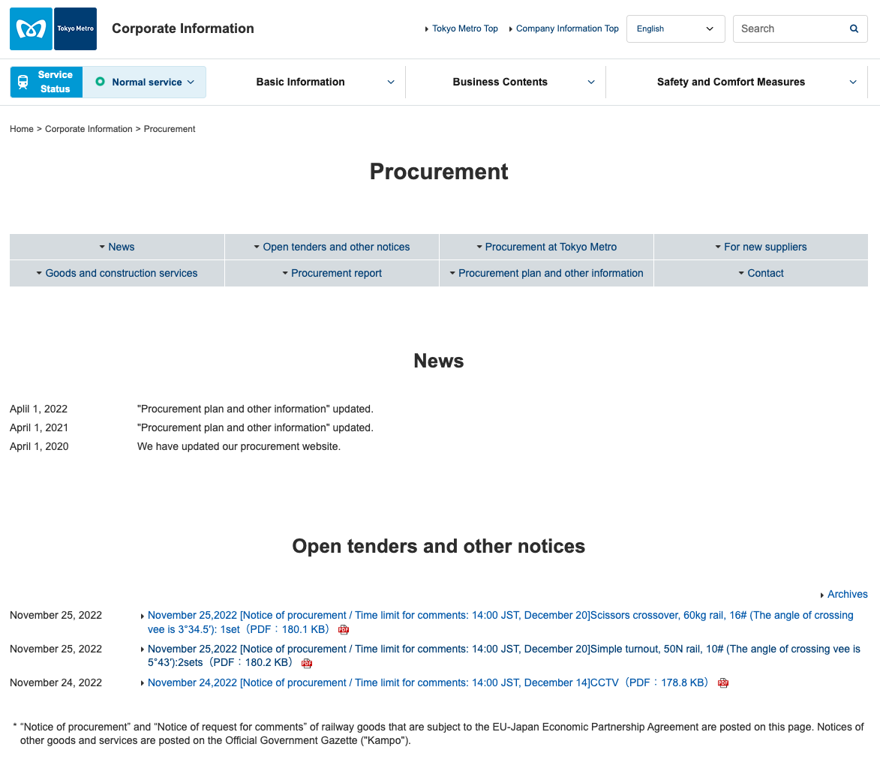
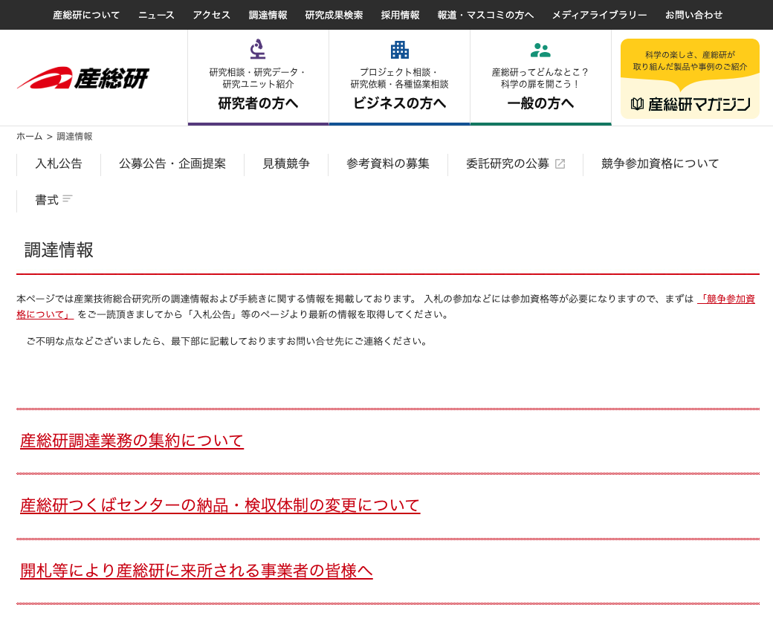
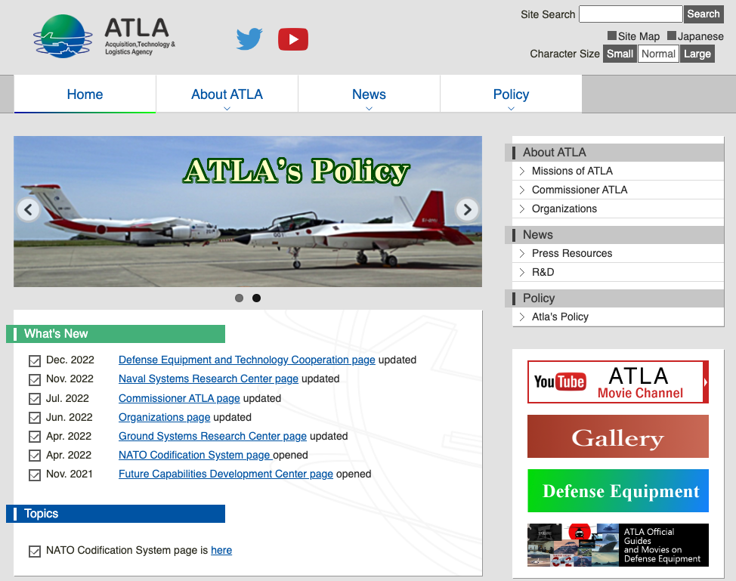
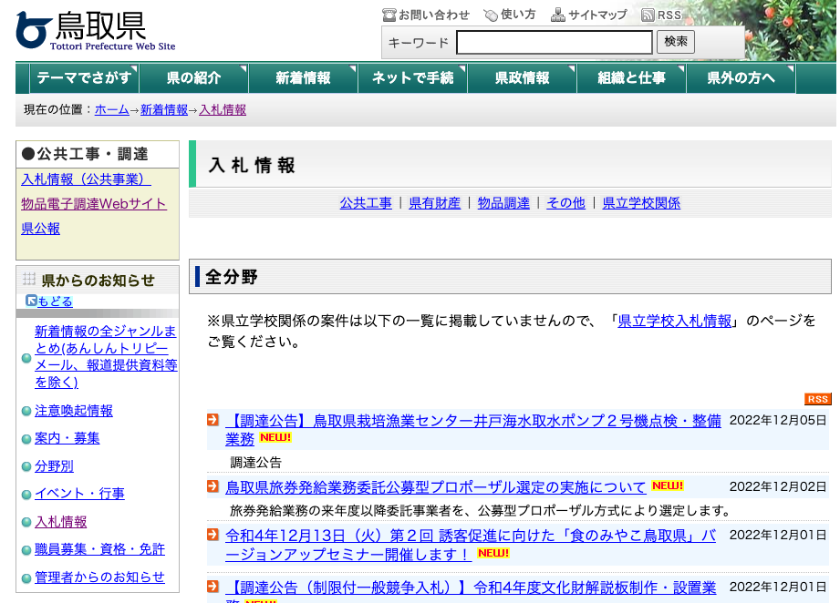
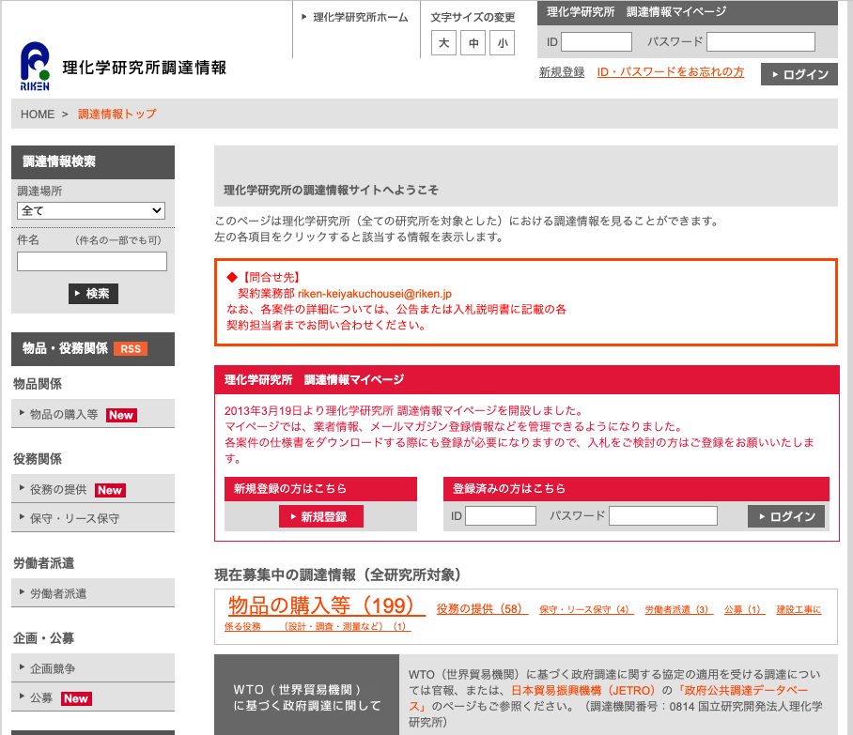
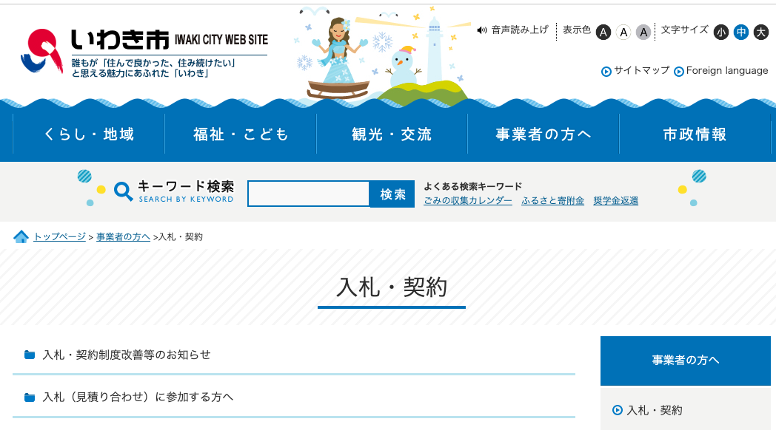
Topic Title
Finding tender information
Japanese language information
Government entity level
1000s of Webpages and/or Online tender portals
Department/Agency level
Public Joint platforms
Prefectures and municipalities
Commercial services
Meta sites gathering notices (NJSS)
Sector-specific (Construction Daily)
eu-japan.eu

Slide 9
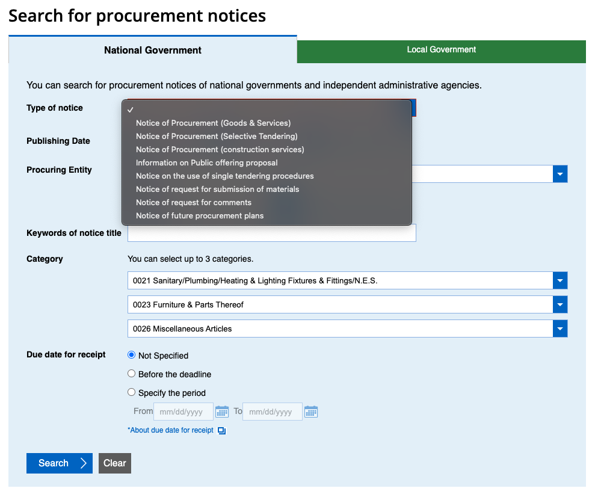
Finding tender information
Topic 4
https://www.jetro.go.jp/en/database/procurement/
WTO/EPA-regulated contract notices
National/Local government
Various types of notices
eu-japan.eu

Slide 10
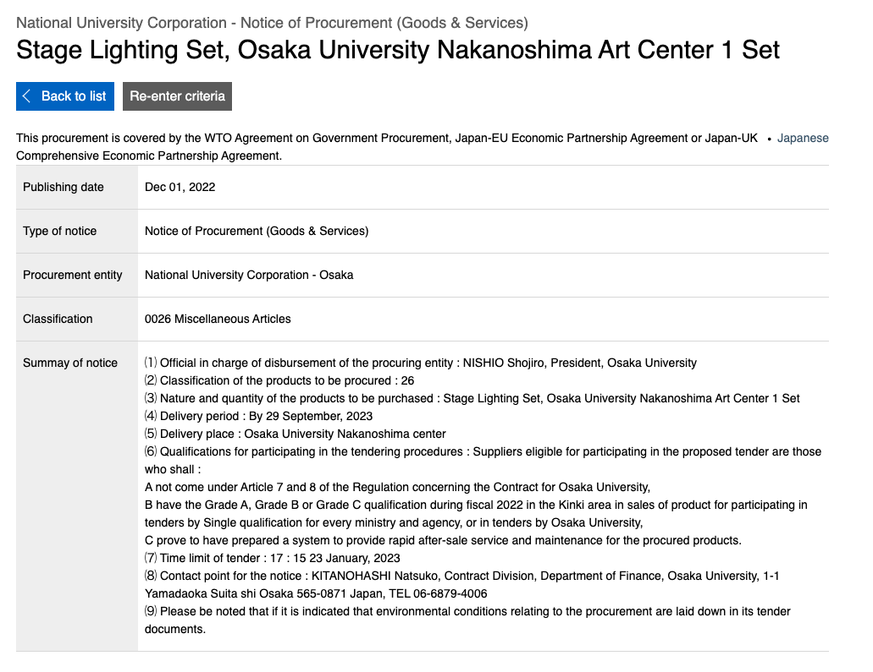
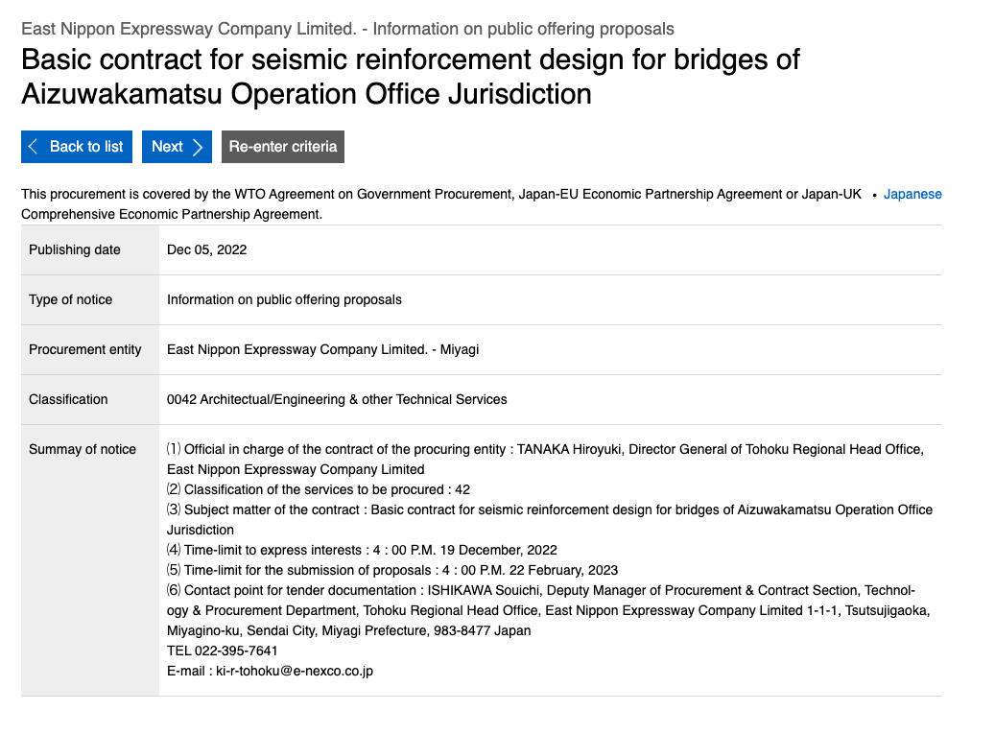
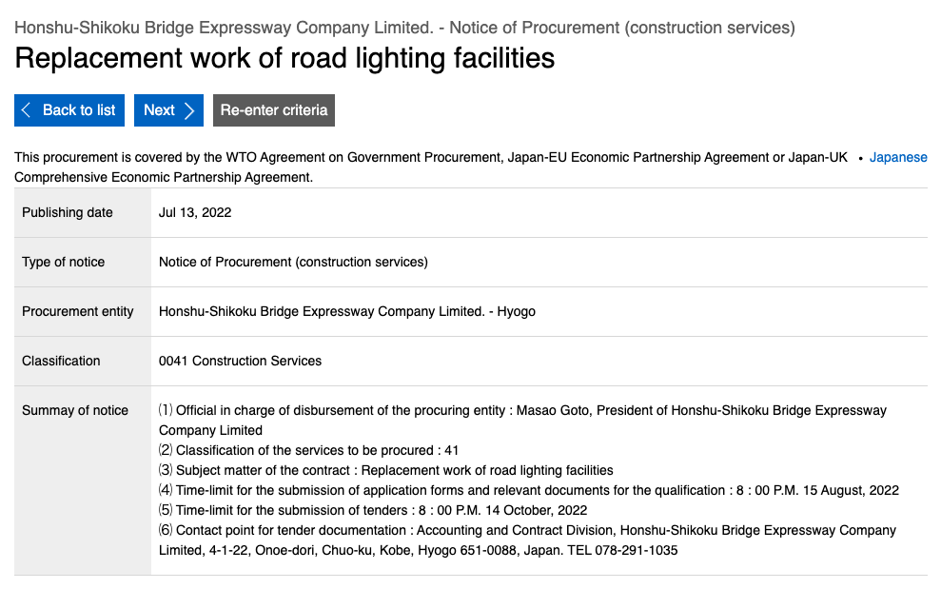
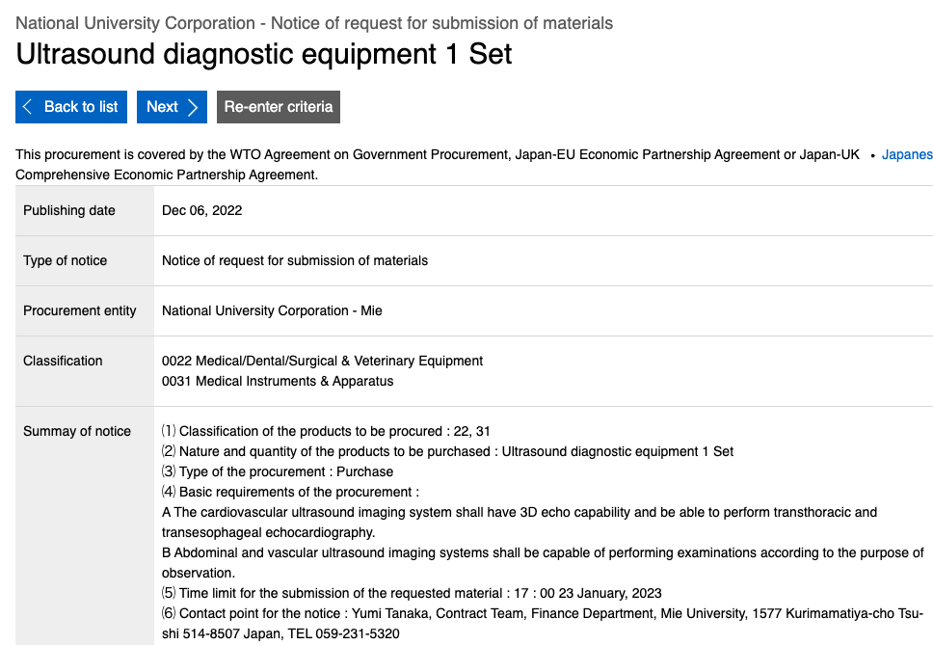
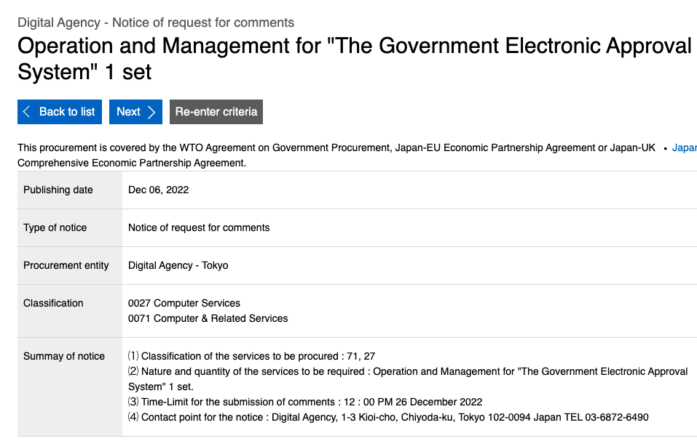
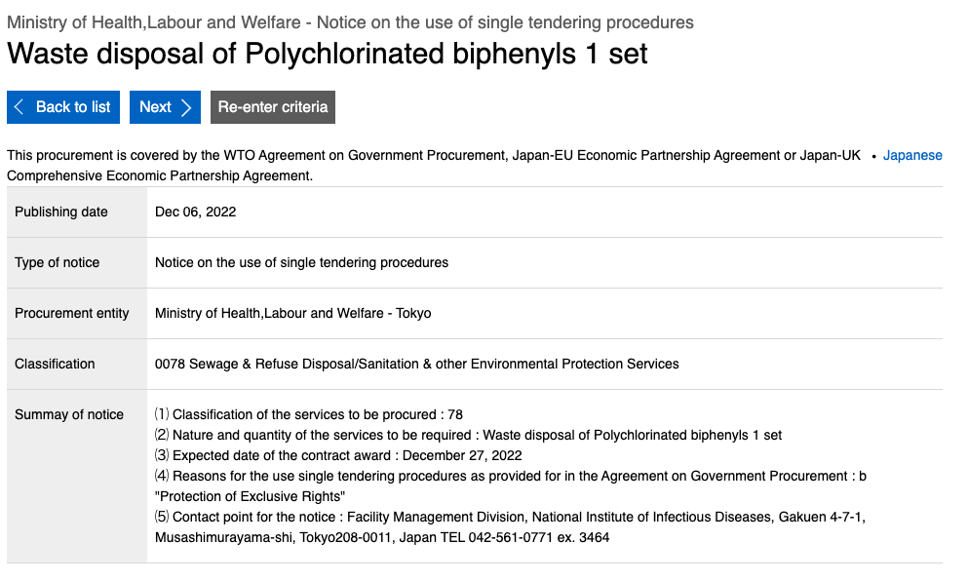
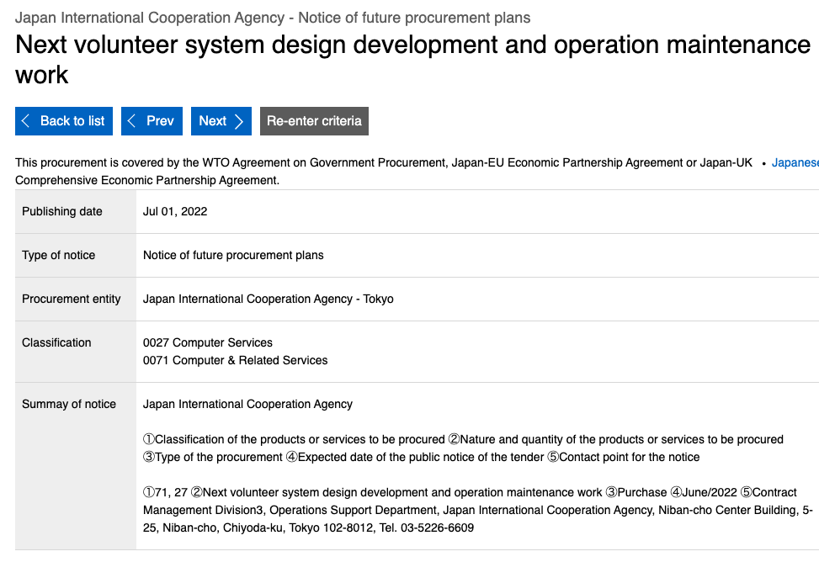
Finding tender information: JETRO
Types of notices
Goods & Services
Selective tender notices
Construction services
Public offering proposals
Single tenders
Submission of materials
Requests for comments
Future procurement plans
eu-japan.eu
Notes:
This is an example of a recent contract offered by a national government organization. It’s a national university in Osaka that needs a stage lighting system for its Art Center.
Here you see the English summary, with provides the minimum of information. Beside the general subject of the contract they provide
= When it needs to be delivered
= Where it needs to be delivered
= Some of the qualifications to be eligible
A article 7 & 8, usual mains that you are not under bankruptcy or insolvency
B have registered as a supplier either under the national government common system or by the entity itself and fall into the category of A,B and C
C can prove you can provided rapid after-sale service and maintenance
DL for the bid (if you are allowed to compete)
Contact point
Environmental conditions
The Japanese version of the notice however will contain much more information: in this case, things like
The method of tendering (It’s. and open tender)
Where the tender specifications can be obtained
Time and location of bid opening (March 13)
Language used in the proceedings (all Japanese)
Whether a deposit or guarantee is required (in this case not)
Requirements: That you have to prove that you can deliver the goods and submit a bid before the deadline, and be available for additional explanations until the bidding day.
A contract is drafted.
Method of assessment to decide winning bidder: Lowest price
Whether negotiation is permitted; No
Referall to tender explanation/specifications.
https://www.jetro.go.jp/gov_procurement/national/articles/254903/2022120100640001.html

Slide 11
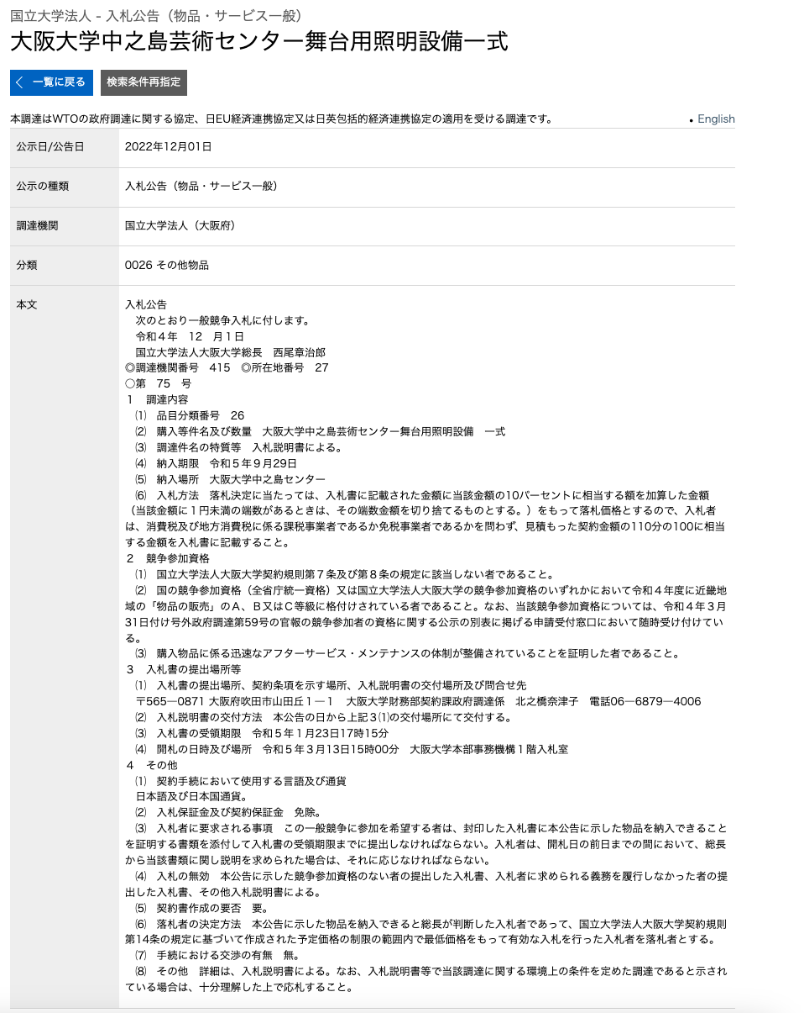
Tender notice (English)
Date of delivery
Place of delivery
Qualifications
Bidding dead line
Contact point
Tender notice (Japanese)
Type of tender
How to get specifications
Method of assessment (lowest price)
DL to submit qualification docs
Time/location of bid opening
Language used
Deposit Y/N
Whether a contract is drafted
Whether negotiations are permitted (No)
eu-japan.eu

Slide 12
Finding tender information
Challenge: How to get further details to determine business case?
Option 1: Call (Will have to be in Japanese)
Option 2: Check whether details are available online
eu-japan.eu

Slide 13
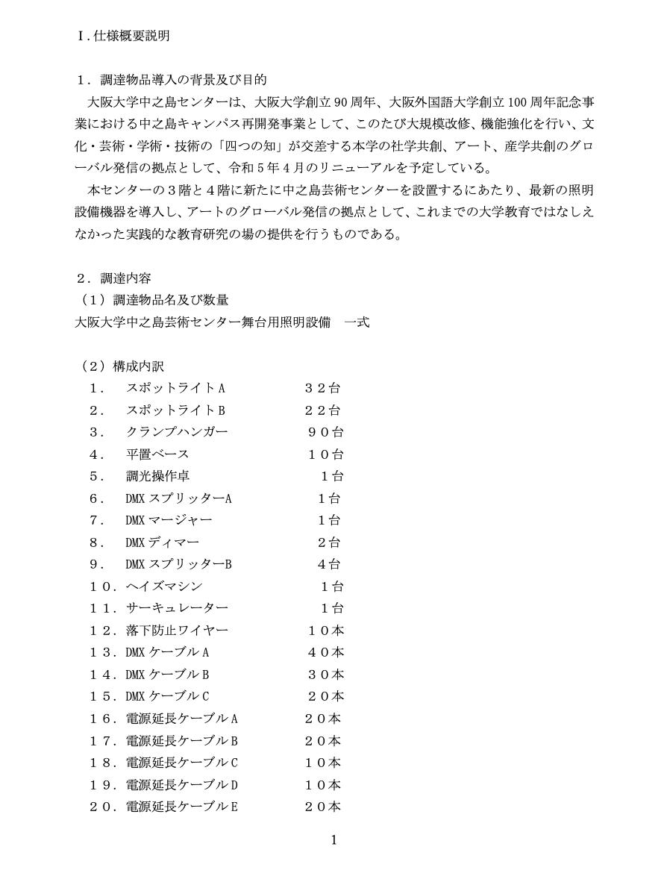
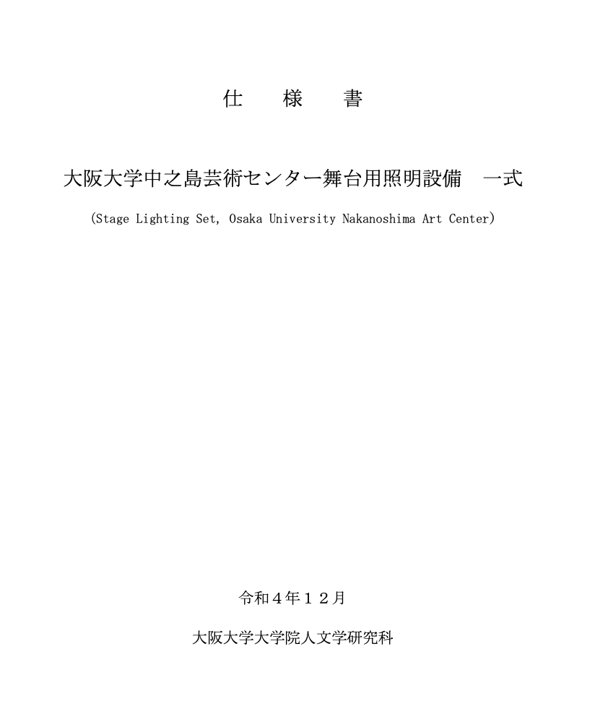
Tender details
Tender explanation (nyūsatsu setsumeisho)
Drawings
Specifications (shiyōsho)
Letter of attorney (inin-jō)
Bidding document (nyūsatsu sho)
Guidelines for drafting technical specs (sakusei yōryō)
Draft contract (keiyakusho an)
List of documents that bidders need to submit
Procurement contracting standards of entity

Slide 14
Finding tender information
Online procurement info systems
Example: Tokyo Metropolitan Government
https://www.e-procurement.metro.tokyo.lg.jp/SrvPublish
Example: Chotatsu Portal (National government entities)
https://www.p-portal.go.jp/pps-web-biz/UAA01/OAA0107
eu-japan.eu

Slide 15
GP in Japan: General Features
Challenges for foreign suppliers at entry phase
Language barrier
Difficulty to determine business case
Burden of translations
Short lead-times
Focus on lowest price
Service requirements
Geographic focus
eu-japan.eu

Slide 16
GP in Japan: General Features
Topic 1
Topic 2
Topic 3
Topic 4
Contact
Question and Answer session
eu-japan.eu

Slide 17
GP in Japan: General Features
Topic 1
Topic 2
Topic 3
Topic 4
Contact
Expert contact
lyckle.griek@eu-japan.or.jp
https://www.eu-japan.eu/government-procurement/ask-expert-government-procurement
The opinions expressed in this Webinar are those of the expert(s) only, and may not necessarily represent the views of the EU-Japan Centre for Industrial Cooperation or of the EU or Japanese Authorities.
No warranty is given for their accuracy or completeness.
eu-japan.eu

