Slide 1
Government procurement in Japan
Topic 1
Topic 2
Topic 3
Topic 4
Contact
Government procurement in Japan
Session 2:
Tender procedures, eligibility & assessment, standards and legal issues
Lyckle Griek
Japan Tax & Public Procurement Helpdesk
eu-japan.eu

Slide 2
GP in Japan: General Features
Topic 1
Topic 2
Topic 3
Topic 4
Contact
Question and Answer
eu-japan.eu

Slide 3
Module 2: Tender procedures etc.
Today’s Module
A ‘standard’ tender procedure
Types of assessment and evaluation
Eligibility requirements (Supplier qualification)
Some legal issues and technical standards
eu-japan.eu

Slide 4
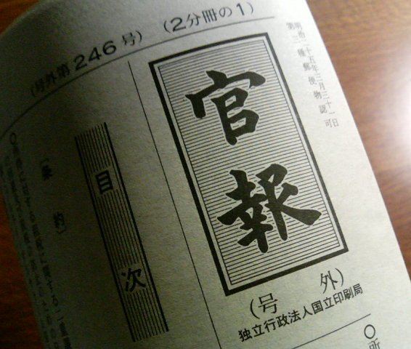
A ‘standard’ tender procedure
Tender notice – Invitation to tender
Explanatory meeting
Expression of interest
Preparation and submission of bidding documents (Online)
Contracting
Opening of bids Announcement of bidding results
Preparatory phase
Topic 1
Topic 2
Securing a budget
Project team
Internal gathering of market information
Prior information notice (public gathering of market information)
drafting of specifications
Request for comments
Topic 3
Topic 4
Contact
WTO/EPA -> Publication on Gazette|JETRO|own portal|websites
Domestic: Chotatsu Portal|own portal|websites
Publication of specifications
If held, within 2-3 weeks (not common in case of construction)
Online/physical meeting (sometimes required)
3-4 weeks after notice
Submission of Supplier Qualification documents, licenses and certificates
Also technical documents and past achievements
If not expression of interest, then same documents
Project-structure, breakdown of subcontractors etc.
Bidding document
Conclusion of final contract
Price-negotiation etc. not possible
Strict adherence to conditions and deadlines agreed upon
Delivery/Execution of the contract
Online announcement or bidding room
Same price, repeat with new bids (sometimes lottery)
Alternative: “Dutch auction” (serisage hōshiki)

Slide 5
Module 2: Type of Assessment
Price:
Projected price (yotei kakaku)
Maximum price estimated by government entity (not-disclosed)
Minimum limit price (saitei seigen kakaku)
To prevent ‘dumping’
Also not disclosed
Lowest Price (saitei kakaku)
Still the most common, but bound to rules
Overall Greatest Value (sōgō hyōka hōshiki)
Assessment of (technical proposal) i.c.w. price
Rare in procurement of goods
Growing usage in service provision (IT)
Common in public works contract
eu-japan.eu

Slide 6
Module 2: Eligibility requirements
Japanese government requires suppliers to qualify in advance i.e. become a registered supplier
 | Goods & services | Public works’ construction & services
Central government (Ministries & their agencies) | Common system (Single Supplier qualifications) | Two-step procedure: Keishin business evaluation Qualification at individual entity
WTO Annex 3 (national organizations) | Common system (Single Supplier qualifications) Own supplier registry
Sub-central government (Prefectures & designated cities, core cities) | Own supplier registry
Local government | Own supplier registry
eu-japan.eu

Slide 7
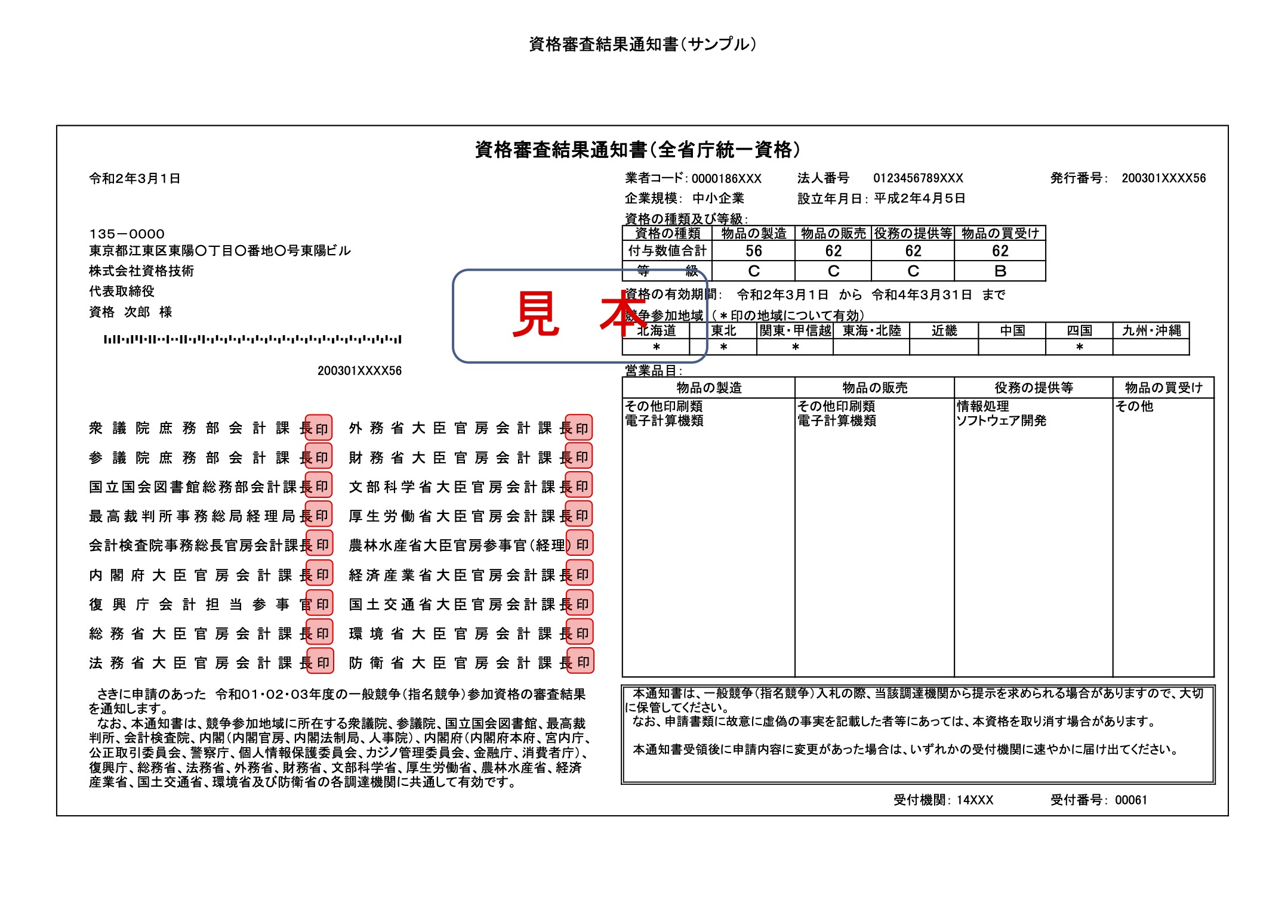
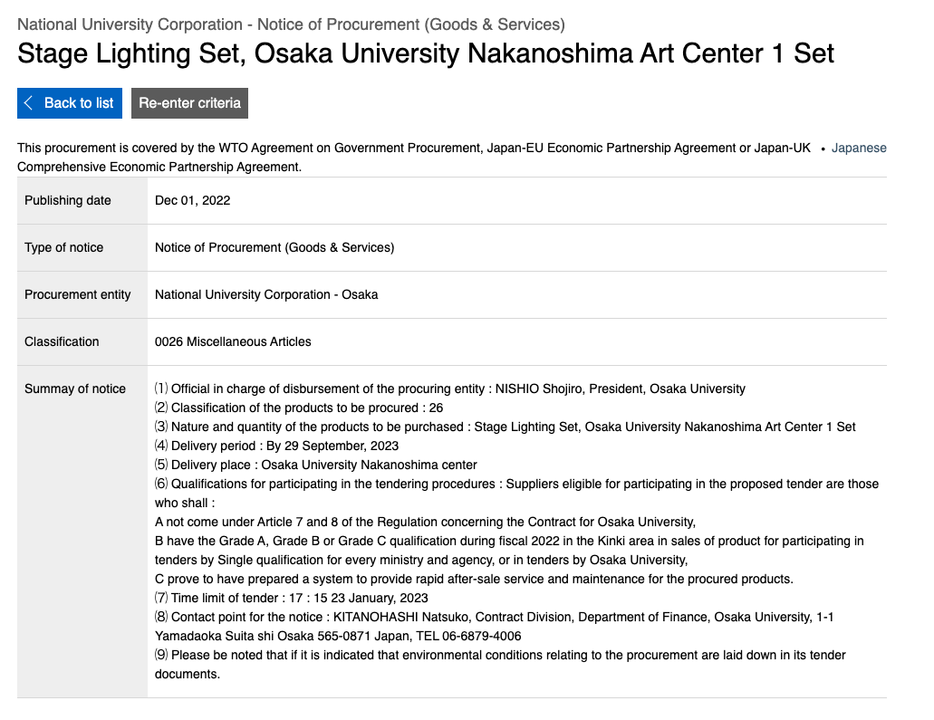
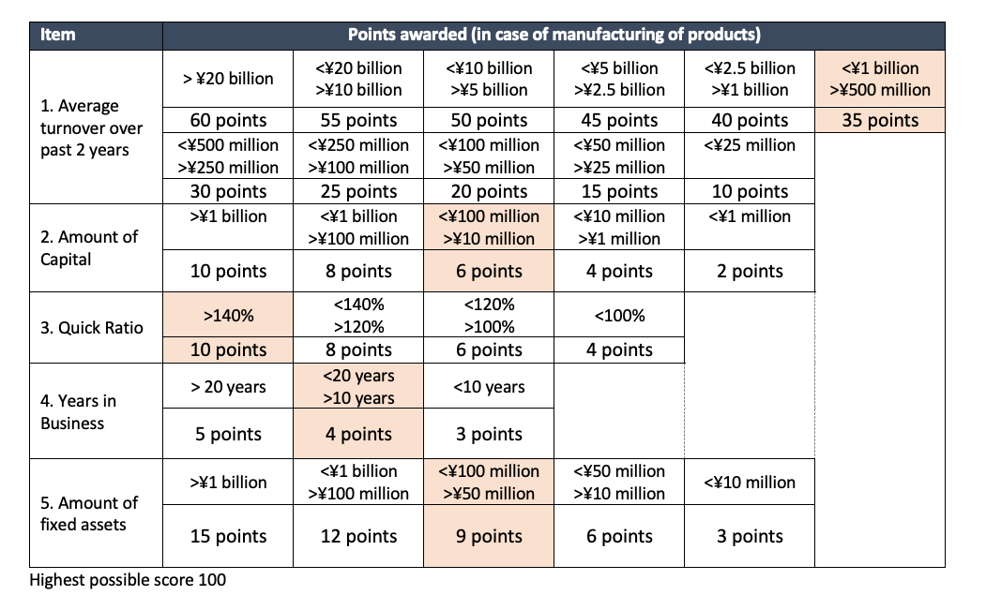
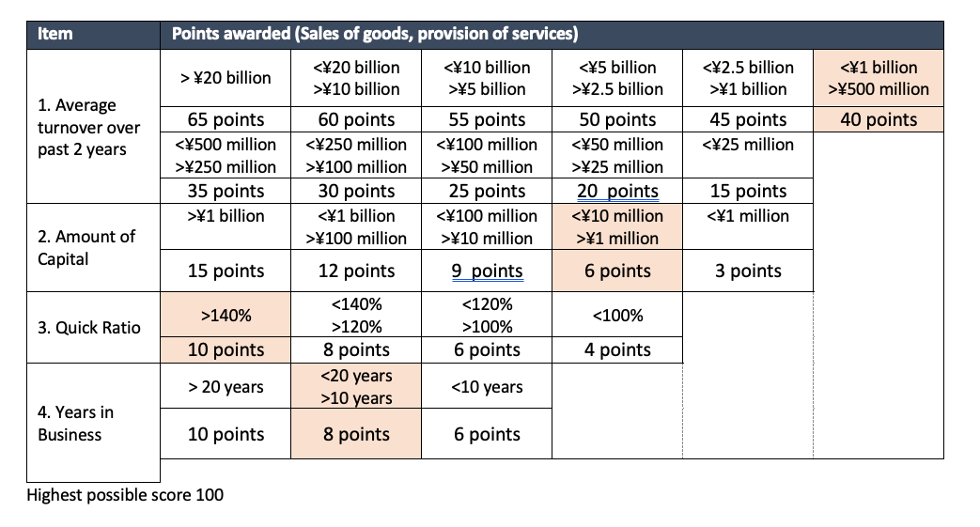
Module 2: Eligibility requirements
Goods & services qualification
Single Supplier qualifications
Validity: 3 years maximum
Submission of company and financial information
Free
Possible online
Other supplier registry procedures
Validity: 2-years maximum
Submission of company and financial information
Free
Not always possible online
Will result in a point-score and classification
Points | Rank | Projected contract value range
 |  | Goods manufacturing | Goods & services provision
>90 | A | > ¥30m (€214,000) | > ¥30m (€214,000)
80-90 | B | >¥20m-¥30m | >¥15m-¥30m
55-80 | C | >¥4m-¥20m | >¥3m-¥15m
<55 | D | <¥4m (€28,500) | <¥3m (21,500)
eu-japan.eu

Slide 8
Module 2: Eligibility requirements
Public works’ construction & services
Two-step procedure:
Keishin business evaluation
External evaluation by third party organization
Qualification at individual entity
Validity is 1 year and 7 months, in practice renewal needs to take place annually in order not to lose the qualification, if done too late you end up with gaps in your eligibility.
eu-japan.eu

Slide 9
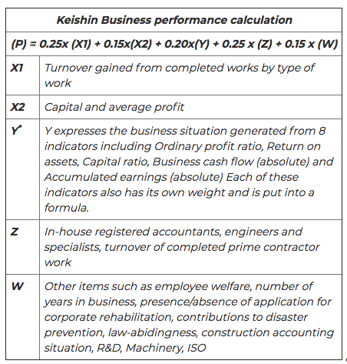
Module 2: Tender procedures etc.
Construction company
Yes
Construction
Licence
Yes
Participate in public works tenders?
No
No
No
Yes
Business evaluation
“Rating & Classification”
Procuring entity
“Overall rating”
By MLIT
“Assessment of business scale aspects”
By MLIT
“Business circumstances analysis”
External organisation (Y-score)
(P) = 0.25 * (X1) + 0.15 * (X2) + 0.20 * (Y) + 0.25 * (Z) + 0.15 * (W)
“Subjective score”
“Objective score”
eu-japan.eu

Slide 10
Module 2: Eligibility requirements
Public works’ construction & services
Two-step procedure:
Keishin business evaluation
External evaluation by third party organization
Qualification at individual entity
Validity is 1 year and 7 months, in practice renewal needs to take place annually in order not to lose the qualification, if done too late you end up with gaps in your eligibility.
Some info in English at MLIT
https://www.mlit.go.jp/sogoseisaku/1_6_hf_000035.html
eu-japan.eu

Slide 11
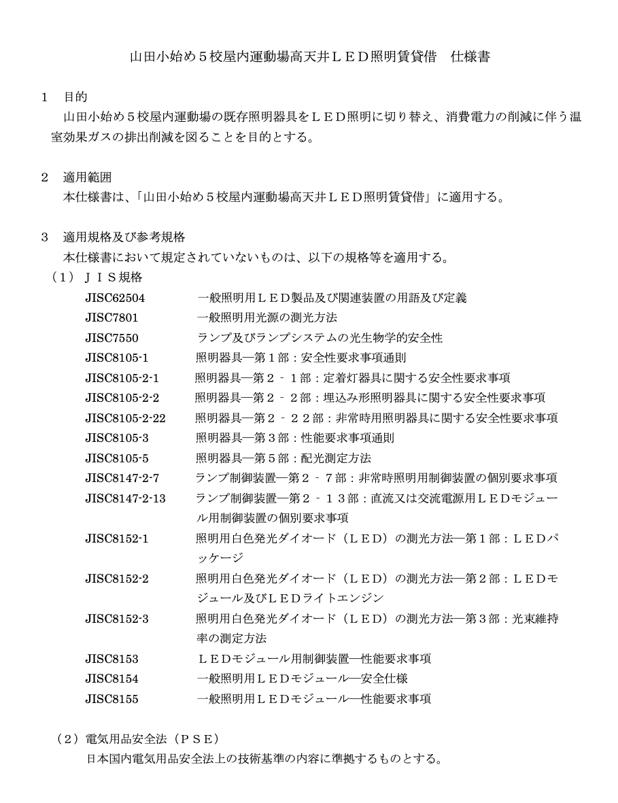
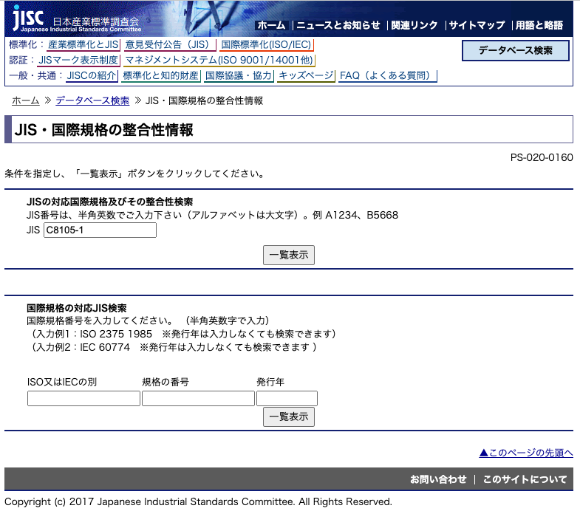
Specifications for lease of High ceiling LED lighting for indoor gymnasiums at 5 Elementary Schools in Nagoya City
Module 2: Standards, certificates, licenses
Licenses & certificates
Will depend on the type of lighting and their usage
When conducting technical or installation activities in Japan:
Qualifications of foreign technician/supervisors need to be approved by MLIT
Japan Industrial Standards (JIS)
Voluntary standards but often required in government tenders
Lighting: JIS C7 XXX (bulbs, lamps etc.) C8 XXX (LED, safety)
Harmonization rates:
38% (IDT) identical with international standards
59% (MOD) modified from international standards
3% (NEQ) not identical
JIS Marking: through Certified Accreditation Body
eu-japan.eu

Slide 12
Specifications for lease of High ceiling LED lighting for indoor gymnasiums at 5 Elementary Schools in Nagoya City
Module 2: Standards, certificates, licenses
PSE standards
Electrical Appliance and Material Safety Act
Category A: Specified appliances (f.i. lamp holders)
Category B: Non-Specified Electrical Appliances and Materials
Companies are obliged to notify METI before starting their business in Japan
Conformity assessment can be undertaken with organizations such as Tüv and others
https://www.meti.go.jp/english/policy/economy/consumer/pse/index.html
eu-japan.eu

Slide 13
Module 2: Tender procedures etc.
Topic 1
Topic 2
Topic 3
Topic 4
Contact
Question and Answer session
eu-japan.eu

Slide 14
Module 2: Tender procedures etc.
Topic 1
Topic 2
Topic 3
Topic 4
Contact
Expert contact
lyckle.griek@eu-japan.or.jp
https://www.eu-japan.eu/government-procurement/ask-expert-government-procurement
The opinions expressed in this Webinar are those of the expert(s) only, and may not necessarily represent the views of the EU-Japan Centre for Industrial Cooperation or of the EU or Japanese Authorities.
No warranty is given for their accuracy or completeness.
eu-japan.eu

