Slide 1
Government procurement in Japan
Topic 1
Topic 2
Topic 3
Topic 4
Contact
Government procurement in Japan
Session 3:
Public sector lighting market &
building partnerships
Lyckle Griek
Japan Tax & Public Procurement Helpdesk
eu-japan.eu

Slide 2
Module 2: Tender procedures etc.
Topic 1
Topic 2
Topic 3
Topic 4
Contact
Module 2:
Tender procedures, eligibility, assessment, standards
Question and Answer
eu-japan.eu

Slide 3
Module 3: Public sector lighting market
Today’s Module
Government Procurement Market Overview
Market entry approaches
Business partnerships
EU-Japan Centre of Industrial Cooperation’s business services
European Enterprise Network (EEN) Japan Helpdesk
Japan Tax & Public Procurement Helpdesk
eu-japan.eu

Slide 4
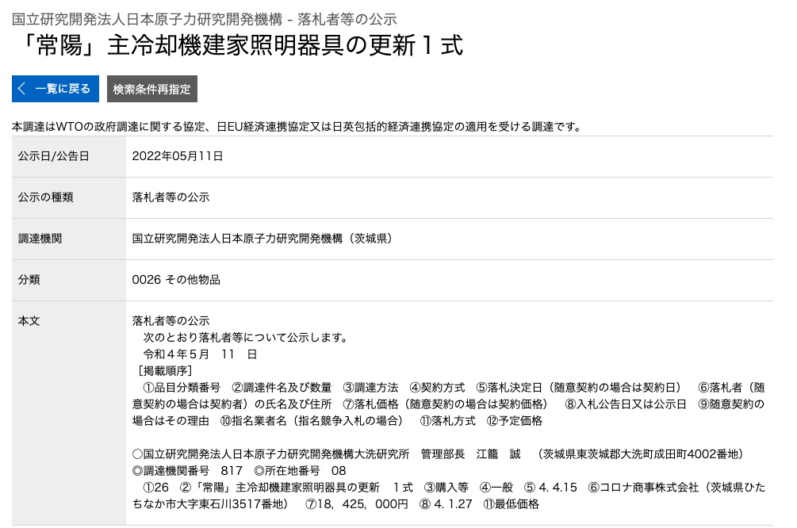
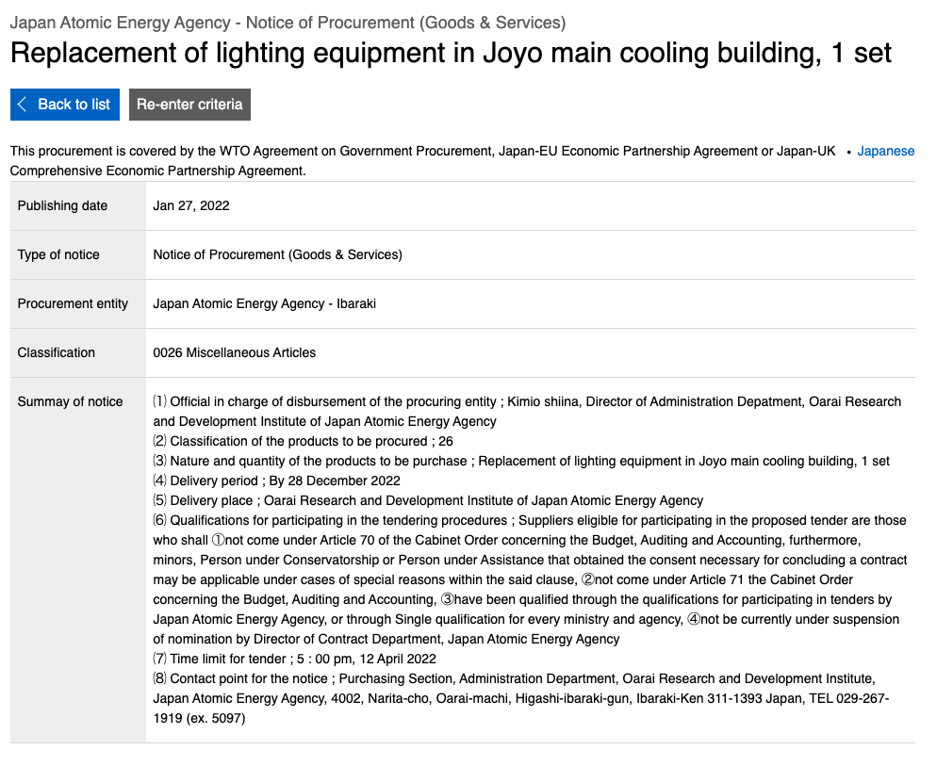
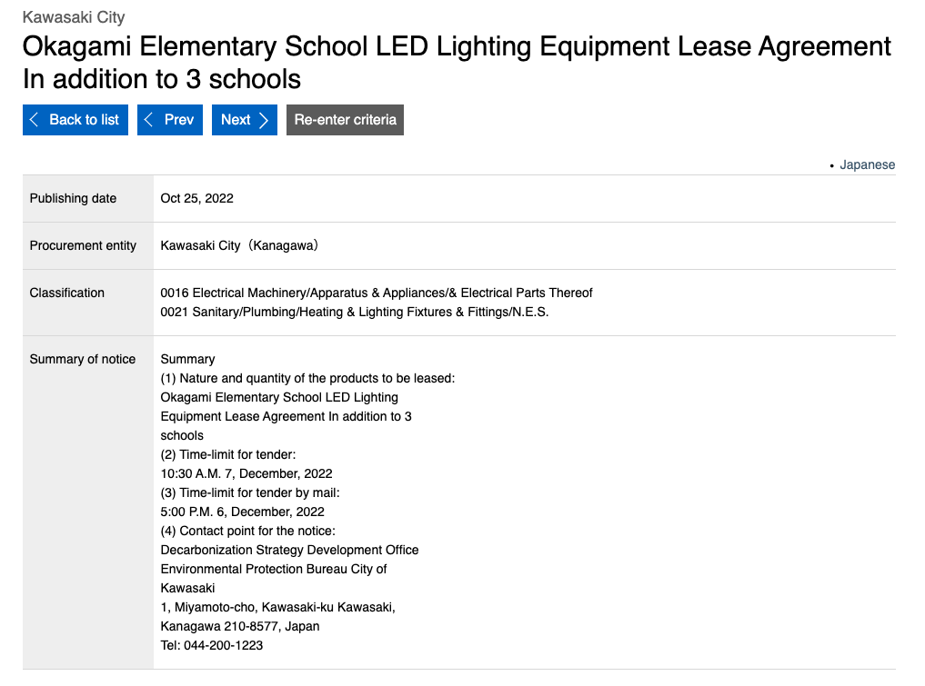
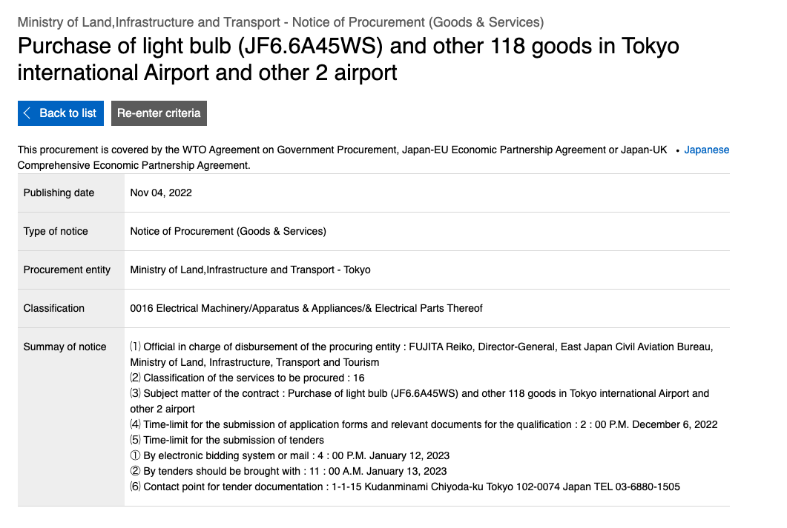
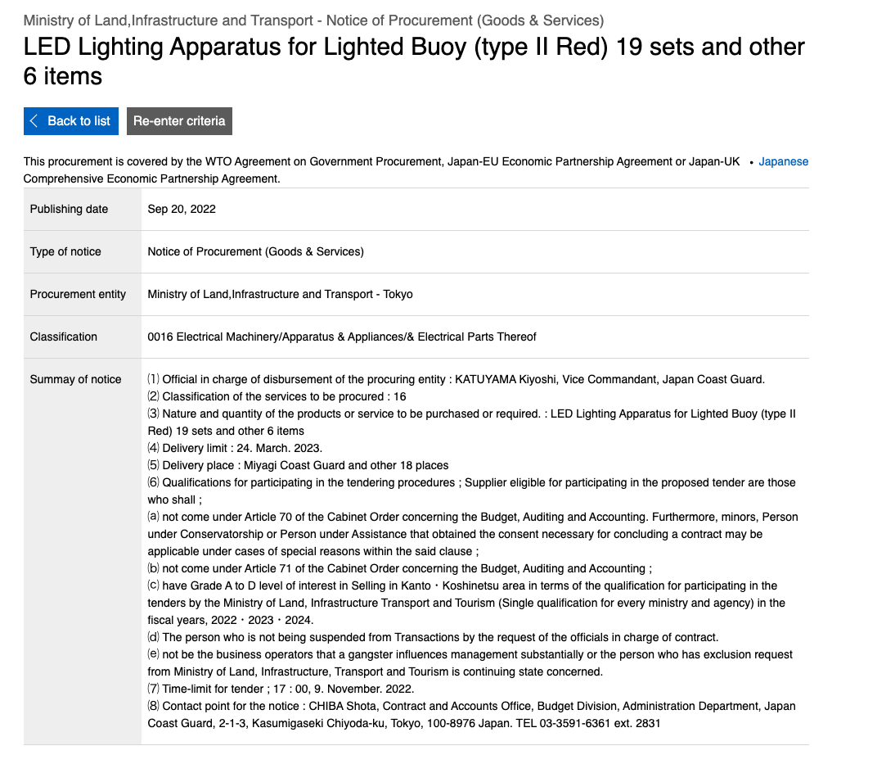
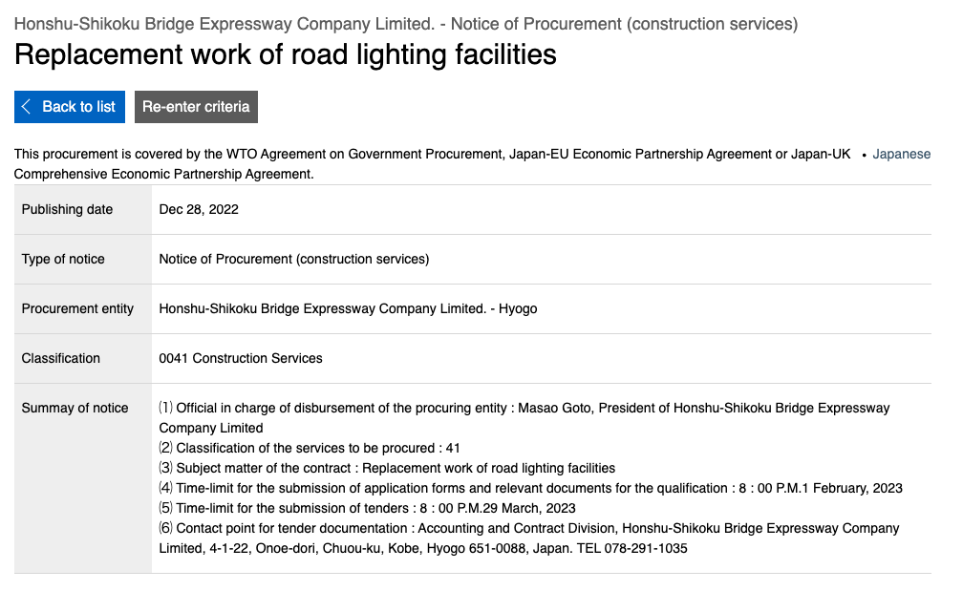
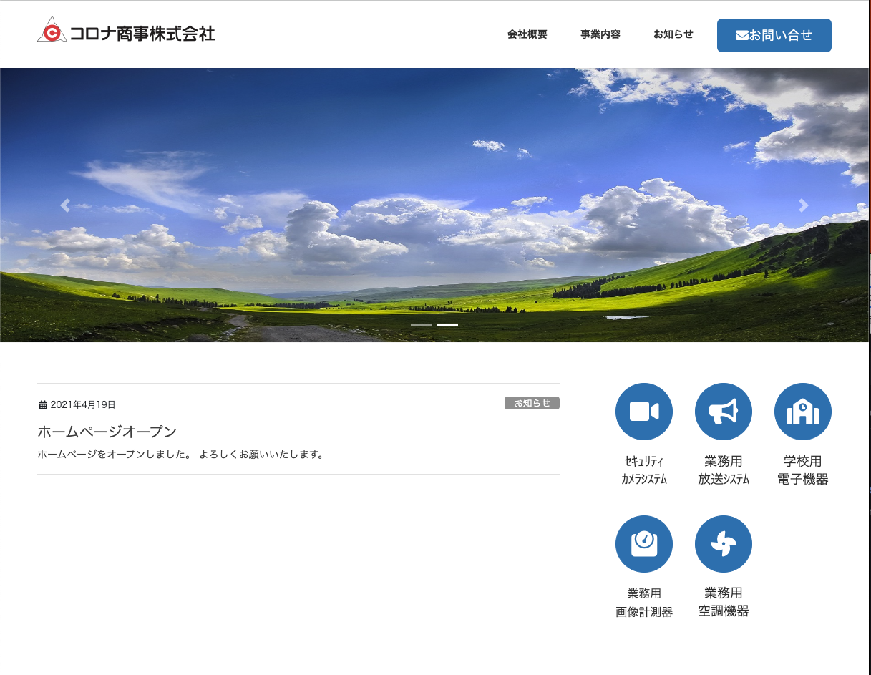
Module 3: Public sector lighting market
Overview
”Are large-value lighting contracts offered?”
WTO/EPA tenders (JETRO)
Cat. | Description | Remarks
21 | Sanitary/Plumbing/Heating & Lighting Fixtures & Fittings/N.E.S). | Broad category, few at central level, sub-central: lease of LED lighting
16 | Electrical Machinery/Apparatus & Appliances/& Electrical Parts | Airport/runway, buoys, traffic lights
41 | Construction Services | Few in number
26 | Miscellaneous Articles | Broad category, incidental contracts related to lighting
eu-japan.eu

Slide 5
Module 3: Public sector lighting market
Large value procurement contracts regulated by WTO/EPA
Few in number
Part of broader procurement contracts
WTO/EPA regulated Public Works Construction contracts
eu-japan.eu

Slide 6
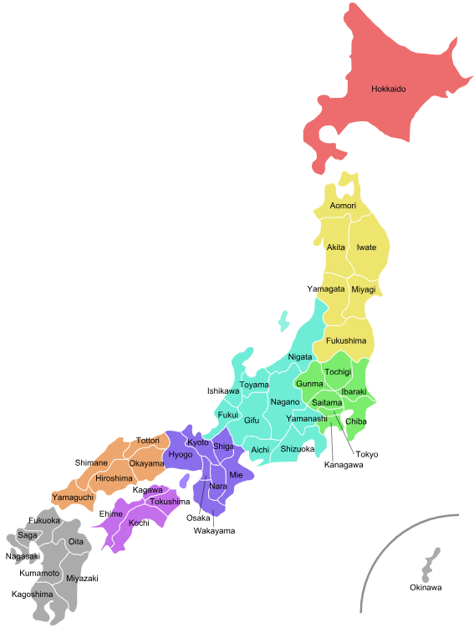
Public works’ construction
Ministry of Land, Infrastructure, Transport and Tourism (MLIT)
9 Regional Development Bureaus
Urban Renaissance Agency
Prefectures
Prefectural infrastructure and housing
Public enterprises (Water works, Sewerage, Electricity)
Construction Bureau (Public infrastructure, flooding control, public housing, public facilities)
(Designated & Core) Cities
Municipal infrastructure and housing
Public enterprises (Water works, Sewerage)
Construction Bureau (Municipal road infrastructure, river management, public housing etc.)
Boards of Education (School buildings etc.)

Slide 7
Public works’ construction
Other organizations/agencies:
NEXCO (Nippon EXpressway COmpany Limited)
Three companies (East, Central, West)
Japan Post
National Hospital Organization
EPA: Japan Community Health Care Organization (JCHO)

Slide 8
Process flow until tender in case of public works’ construction
Steps
Planning
Basic Design
Executive Design
Cost estimation
Project cost est. (1)
Rough work est. (1)
Project cost est. (2)
Rough work est. (2)
Project cost est. (1)
Rough work est. (1)
Tender
Tender
Project cost est. (2)
Rough work est. (2)
Tender
Project period setting
Plan proposal
Budgetary provision
Grasping of conditions
Summarizing for tender
Preparation of basic designs catalogue
Preparation of implemental designs catalogue
Preparation of quantitative calculation catalogue
Activity
Tender
Ordering entity
(Can also be outside architect/ construction consultant)
Design/Engineer
(Design/Engineering office)
Design/Engineer
(Design/Engineering office)
Design/Engineer
(Can also be external cost calculator)
Executor
Gov. office
Cost estimation
Actual construction in separate tenders as well:
Construction of the structure
Electrical Installations
Mechanical Installations
Sewerage etc.
Setting of projected price (budget)
Gathering of estimates from manufacturers
Entry into cost calculation system by cost calculator
Entry into cost calculation system ordering entity
Affirmation of design catalogue
Tender
Notice
Setting of estimate unit price
Design/Engineer
(Design/Engineering office)
Ordering entity
(Ordering department)
Design/Engineer
(Can also be external cost calculator)
Ordering entity
(Ordering department
Ordering entity
(Ordering department

Slide 9
Public works’ construction
General observations
Highly advanced, driven by challenges of natural disasters
Highly protected sector, very locally oriented
Local construction companies win the contracts
Very large public works projects won by Japan’s Zenekon
Labor shortages
Cause for cancellation of tenders and driving up prices
Most local governments have financial difficulties

Slide 10
Module 3: Public sector lighting market
Large value procurement contracts regulated by WTO/EPA
Few in number
Part of broader procurement contracts
WTO/EPA regulated Public Works Construction contracts
As a result -> Necessity to focus on
Domestically regulated government procurement or
Subcontracting, JV or become supplier to companies winning contracts or
Targeted marketing to ‘develop’ single tender contracts
eu-japan.eu

Slide 11
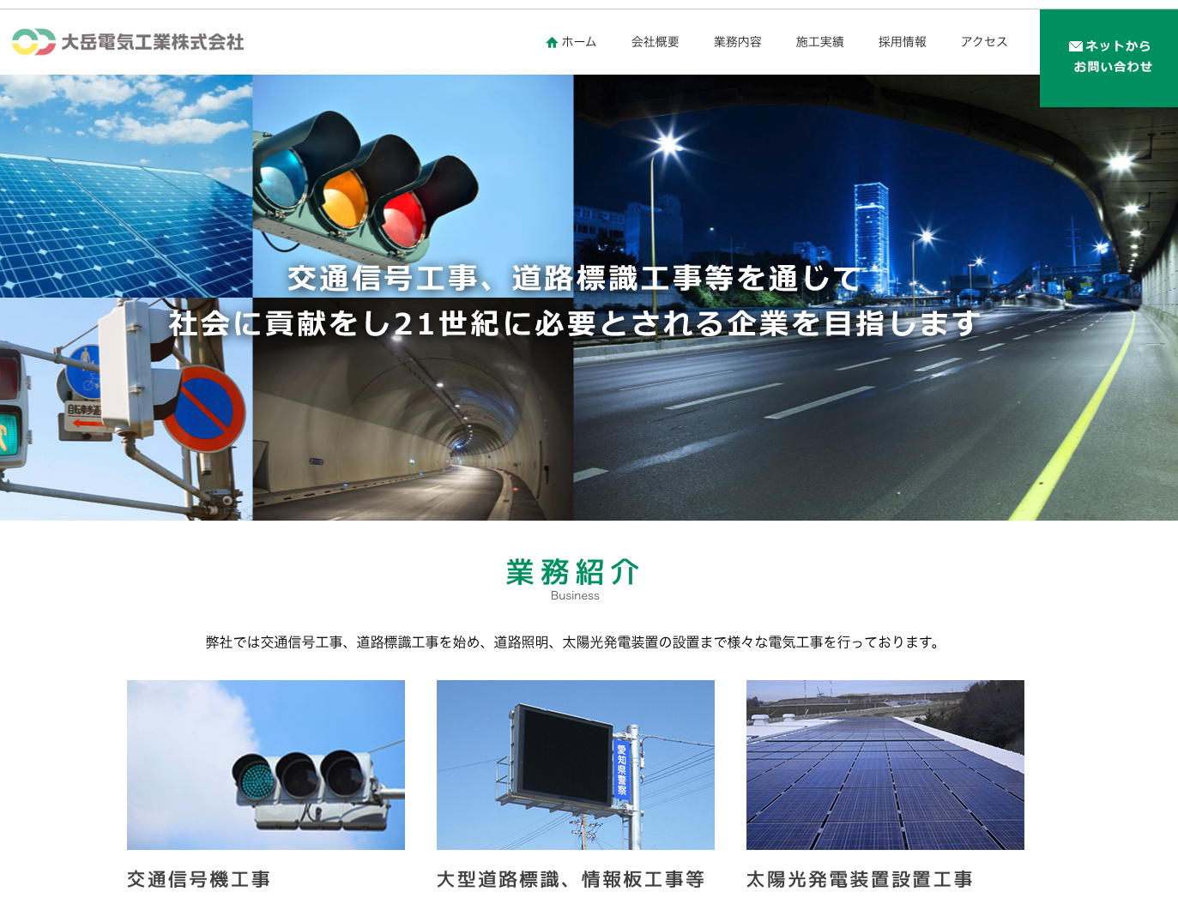
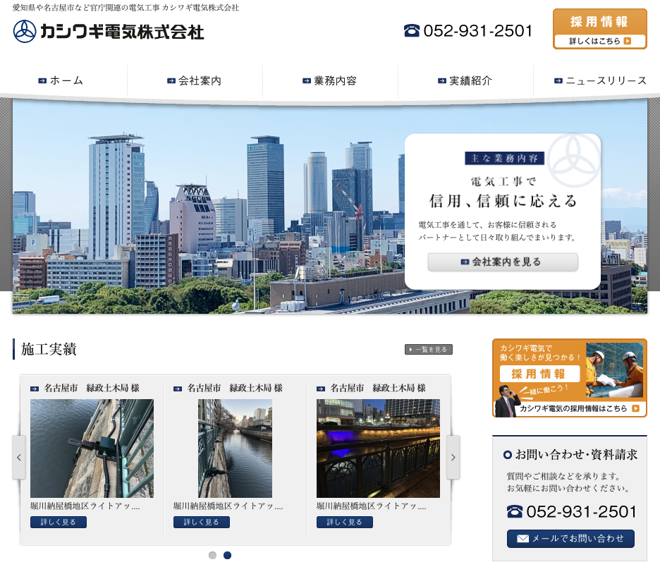
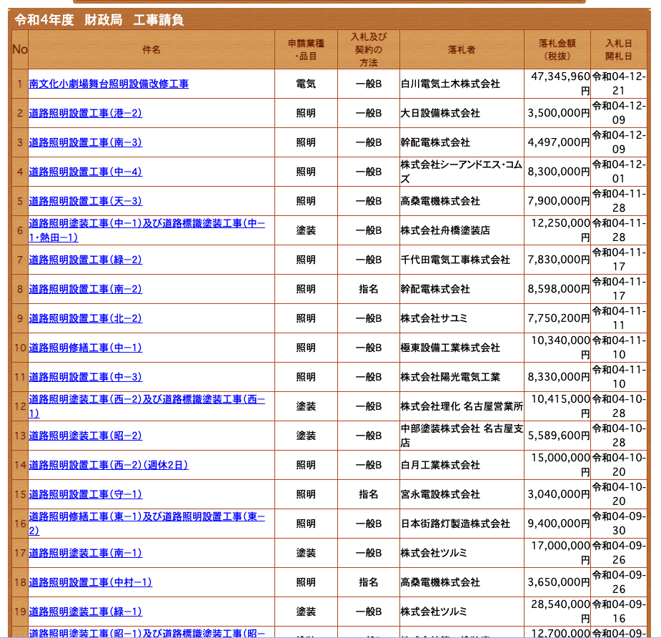
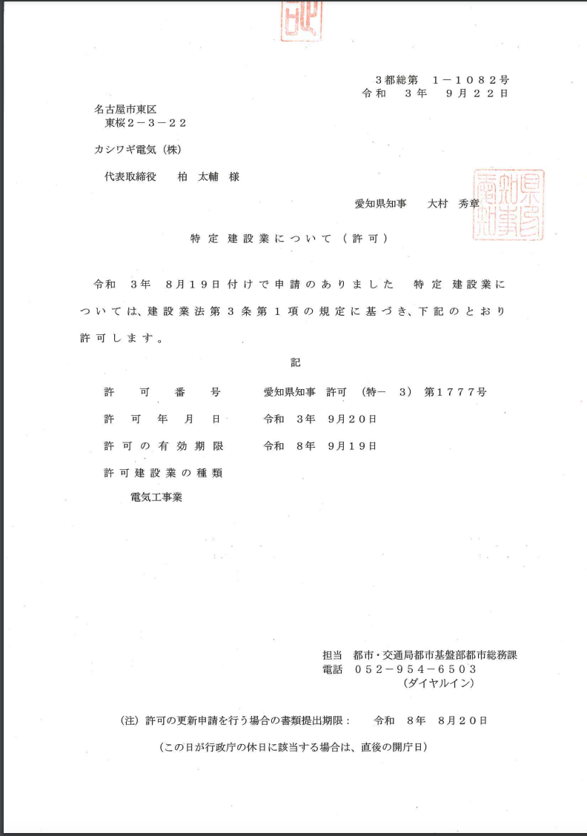
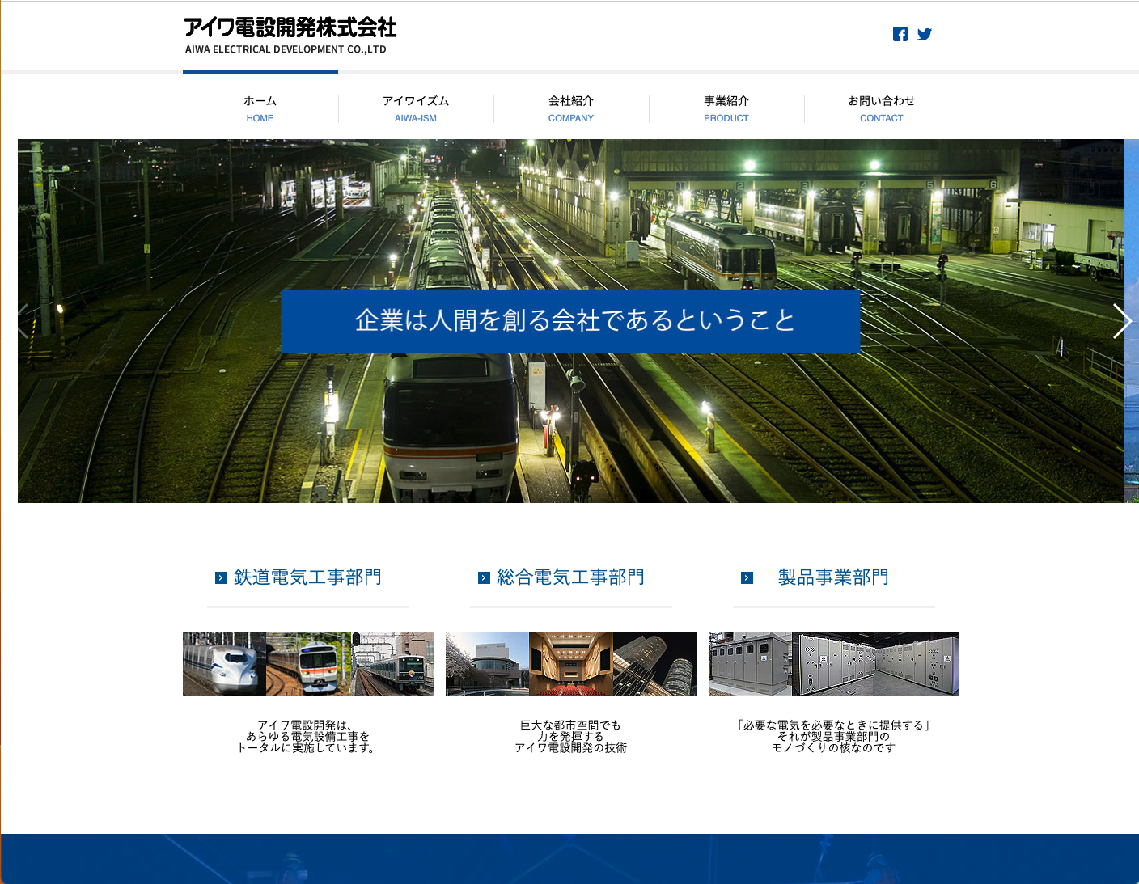
Module 3: Public sector lighting market
Domestically regulated lighting contracts
Usually classified as construction work
Awarded to locally operating electrical installation companies
Challenges
Obtaining necessary licenses
MLIT Electrical Construction Work license, (denki kouji)
qualifications to participate in tenders
De facto local presence required
eu-japan.eu

Slide 12
Module 3: Public sector lighting market
Subcontracting, Joint Ventures, becoming supplier to companies winning contracts
Challenges
Development of partnerships
How to be considered as a partner/subcontractor for a government contract
Architects, designer/engineering offices
Find a suitable distributor in a myriad supply chain (JLMA)
Trading houses (shosha) vs. (Specialist) distributor/Agent
Look at the ‘coverage’ (national network Y/N?)
Japan Lighting Manufacturers Association
eu-japan.eu
Notes:
¥

Slide 13
Module 3: Public sector lighting market
Targeted marketing to ‘develop’ single tender contracts
In case of unique products/services/solution
Japanese language capability and local representative essential
Example: Ichoosr (Netherlands)
Solar panel group buying

Slide 14
Module 3: EU-Japan Centre Business Services
Europe Enterprise Network Japan
https://www.een-japan.eu/
eu-japan.eu

Slide 15
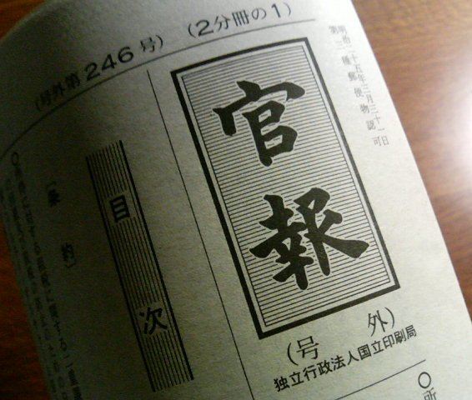
Module 3: JTPP Helpdesk
Tender notice – Invitation to tender
Explanatory meeting
Expression of interest
Preparation and submission of bidding documents (Online)
Contracting
Opening of bids Announcement of bidding results
Preparatory phase
Topic 1
Topic 2
Topic 3
Topic 4
Contact
Market information
Weekly Tender Digest (free)
PP Market Quick Scan (free)
Tailor-made monitoring (free)
Provisional translations of specifications (free)
Supplier Qualification Service (free)
Assistance with licenses’ applications
Arranging of translators
Assistance during contracting

Slide 16
Module 2: Tender procedures etc.
Topic 1
Topic 2
Topic 3
Topic 4
Contact
Question and Answer session
eu-japan.eu
Notes:
So, that is my talk for this session, any questions?

Slide 17
Module 2: Tender procedures etc.
Topic 1
Topic 2
Topic 3
Topic 4
Contact
Expert contact
lyckle.griek@eu-japan.or.jp
https://www.eu-japan.eu/government-procurement/ask-expert-government-procurement
The opinions expressed in this Webinar are those of the expert(s) only, and may not necessarily represent the views of the EU-Japan Centre for Industrial Cooperation or of the EU or Japanese Authorities.
No warranty is given for their accuracy or completeness.
eu-japan.eu

