Slide 1

Japan-EU Economic Relations and the EU-Japan Centre for Industrial Cooperation
October 13, 2026
FONASBA Annual General Meeting Tokyo, Japan 2026
Yasuo Tanabe
Managing Director
EU-Japan Centre for Industrial Cooperation

Slide 2

Outline
1 Evolution of Japan–EU Relations
2 Japan–EU Economic Partnership Agreement
3 Japan–EU Strategic Partnership
4 Japan–EU Green Alliance
5 Japan–EU Digital Partnership
6 Economic Security and Supply Chain Resilience
7 Japan–EU Competitiveness Alliance
8 Japan’s Association to Horizon Europe
9 Japan–EU Business Round Table (BRT)
10 EU-Japan Centre For Industrial Cooperation
11 Conclusion: Key messages

Slide 3

1. Evolution of Japan–EU Relations
1958: Establishment of the EEC (European Economic Community)
1967: Establishment of the EC (European Communities)
Integration of the three European Communities: the European Economic Community, the European Coal and Steel Community, and Euratom
1970s–early 1980s: Era of Trade Frictions
- 1982: Poitiers customs clearance dispute over VTRs in France
- 1983: Voluntary export restraint on automobiles, etc.
Late 1980s–1990s: Shift toward Japan–EC Cooperation
- 1987: Establishment of the EU–Japan Centre for Industrial Cooperation
- 1991: Joint Declaration on Relations between Japan and the European Community
- 1993: Launch of the EC Single Market and establishment of the European Union (EU)
- Late 80s-90s: a lot of Japan’s investment in the EU region

Slide 4
1. Evolution of Japan–EU Relations
2000s–2010s: Deepening of Japan–EU Cooperation（Expansion of cooperation in science and technology, nuclear energy, competition policy, Mutual Recognition Agreements (MRAs), and other areas）
2019: Entry into force of the Japan–EU Economic Partnership Agreement (EPA) and the Strategic Partnership Agreement (SPA)
2020s: Era of the Japan–EU Strategic Partnership(Green Alliance, Digital Partnership, Competitiveness Alliance, etc.)
-Expanding cooperation into economic security, supply chains, digital transformation, green transition, and other strategic areas

Slide 5
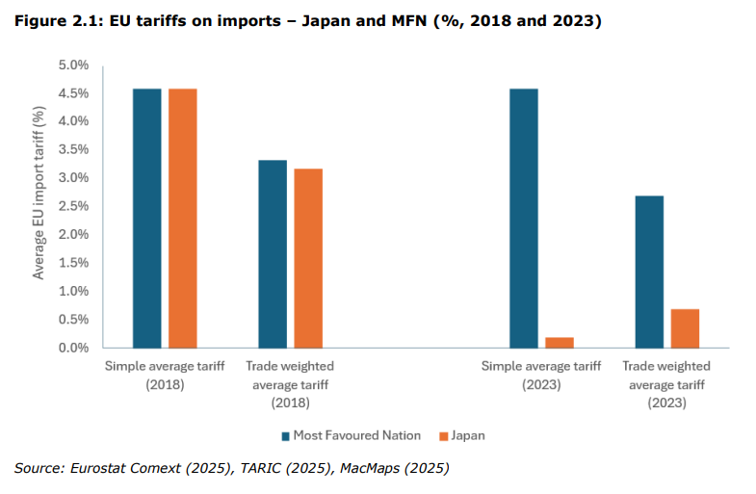
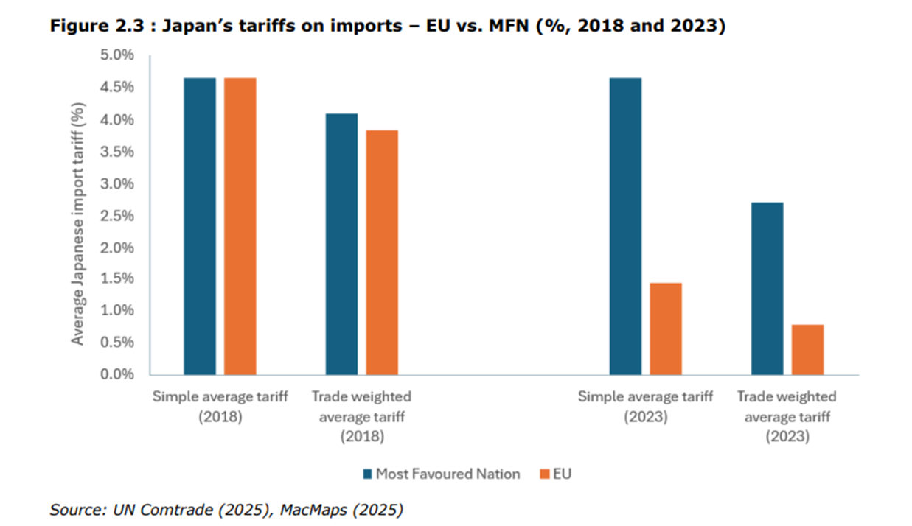
2. Japan-EU Economic Partnership Agreement(February 2019)

Slide 6
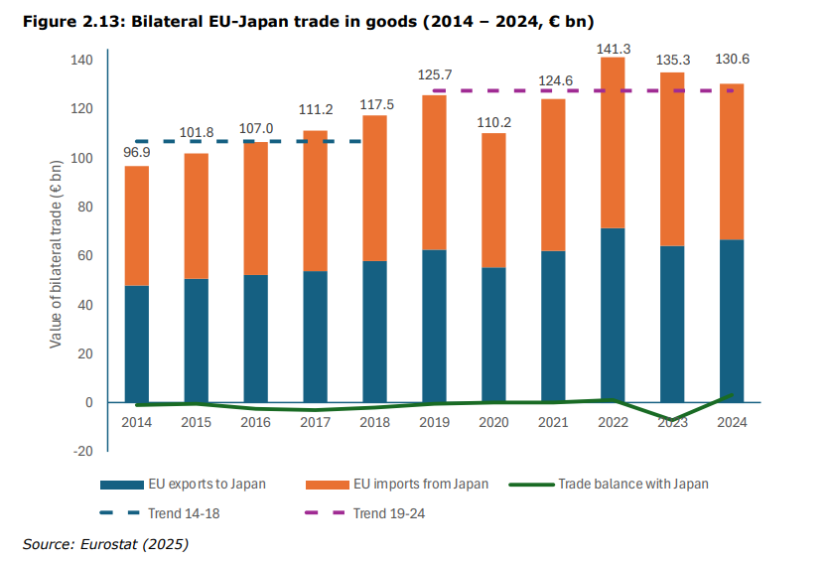
2. Japan-EU Economic Partnership Agreement

Slide 7
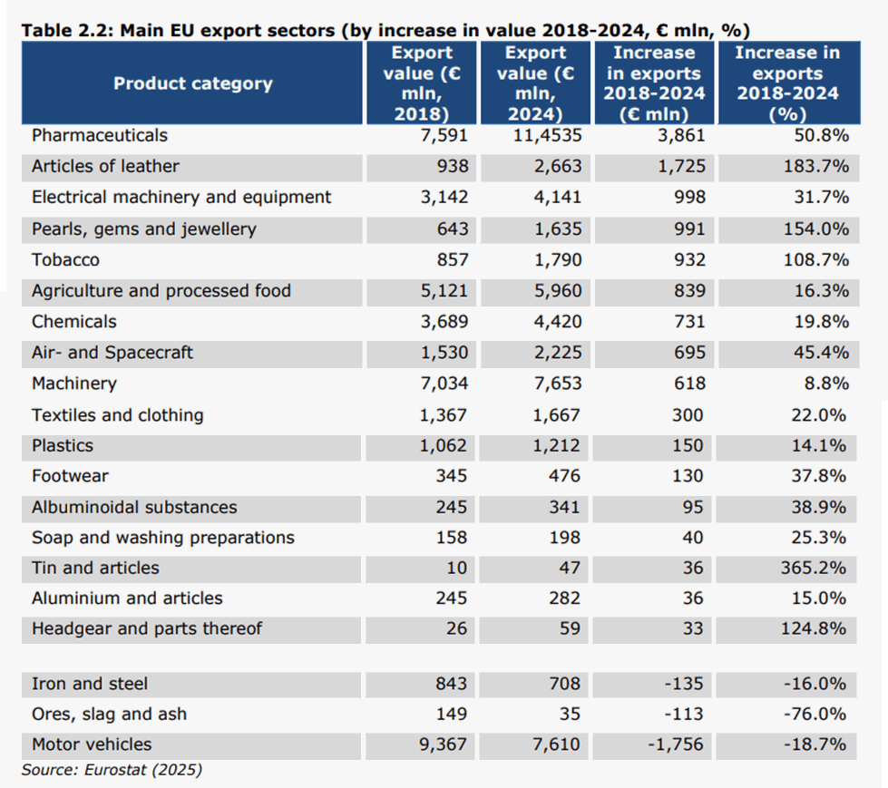
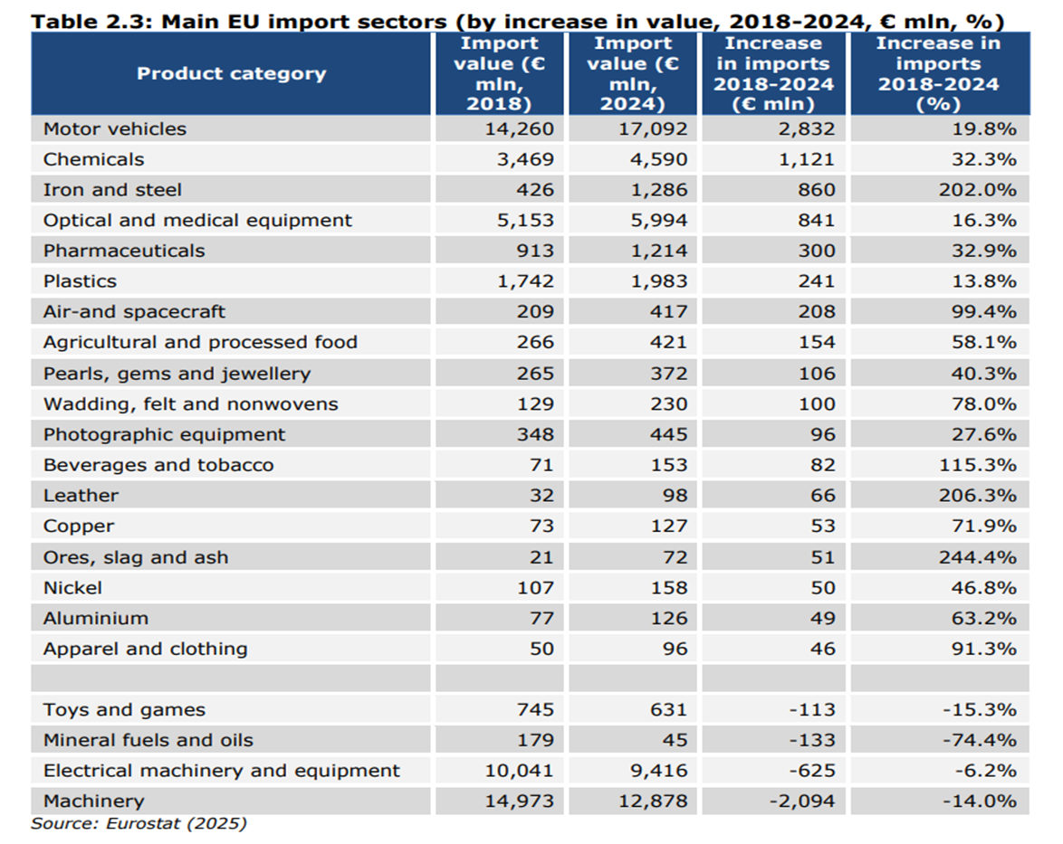
2. Japan-EU Economic Partnership Agreement

Slide 8
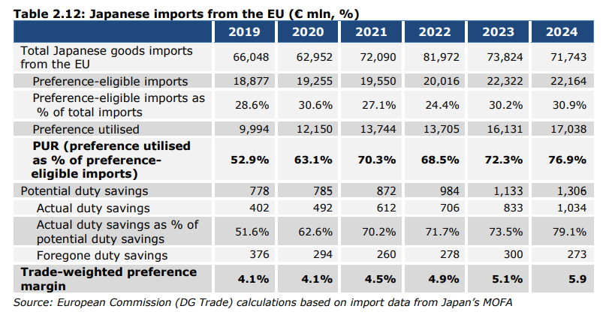
2. Japan-EU Economic Partnership Agreement

Slide 9
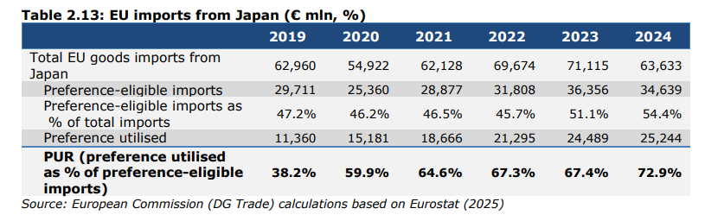
2. Japan-EU Economic Partnership Agreement

Slide 10
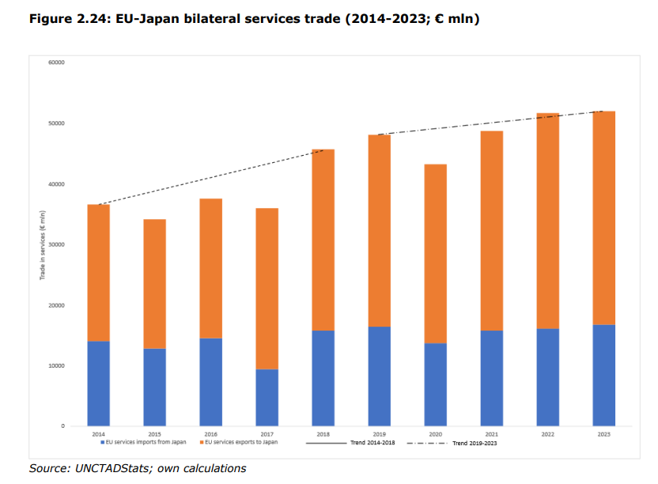
2. Japan-EU Economic Partnership Agreement

Slide 11
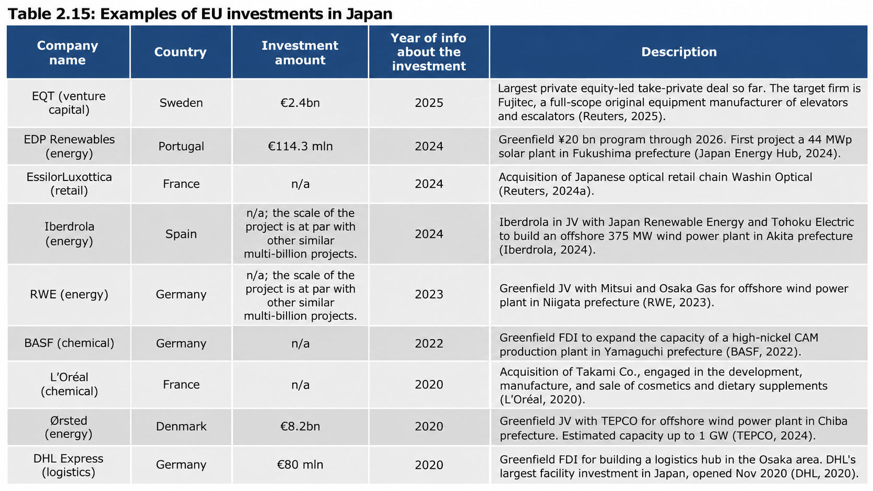
2. Japan-EU Economic Partnership Agreement

Slide 12
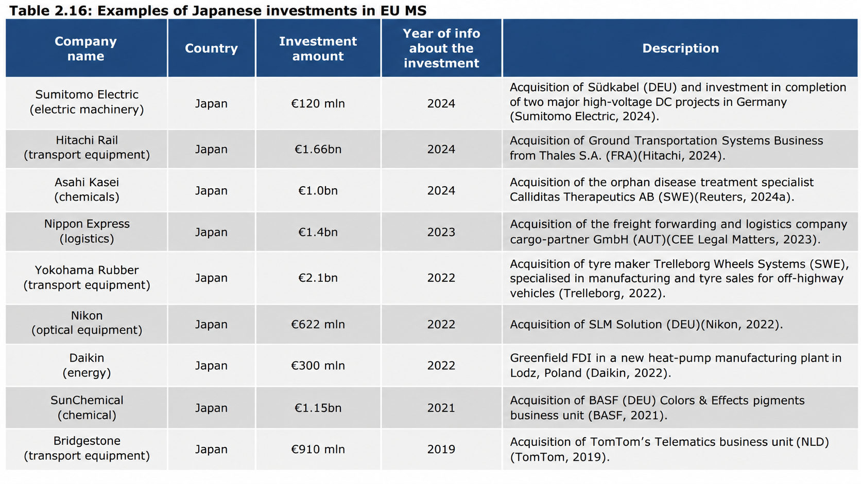
2. Japan-EU Economic Partnership Agreement

Slide 13
3. Japan-EU Strategic Partnership Agreement (February 2019)
Japan, EU and the Member states will cooperate/coordinate in the areas listed below, based on the principles of mutual respect, equal partnership and respect for international law.
International and regional cooperation and reform of the UN
Development policy
Disaster management and humanitarian action
Economic and financial policy
Science, technology and innovation
Transport
Outer space
Industrial cooperation
Customs
Taxation
Tourism
Information society
Consumer policy
Environment
Climate change
Urban policy
Energy
Agriculture
Fisheries
Maritime affairs
Employment and social affairs
Health
Judicial cooperation
Combating corruption and
organised crime
Combating money laundering and financing of terrorism
Combating illicit drugs
Cyber issues
Passenger name records
Migration
Personal data protection
Education
Youth and sport
Culture
Promotion of shared values and principles
Promotion of peace and security
Crisis management
Non-proliferation of WMD and disarmament
Transfer control of conventional weapons
Investigation and prosecution of serious crimes
Counter-terrorism
Chemical, biological, radiological and nuclear risk mitigation

Slide 14
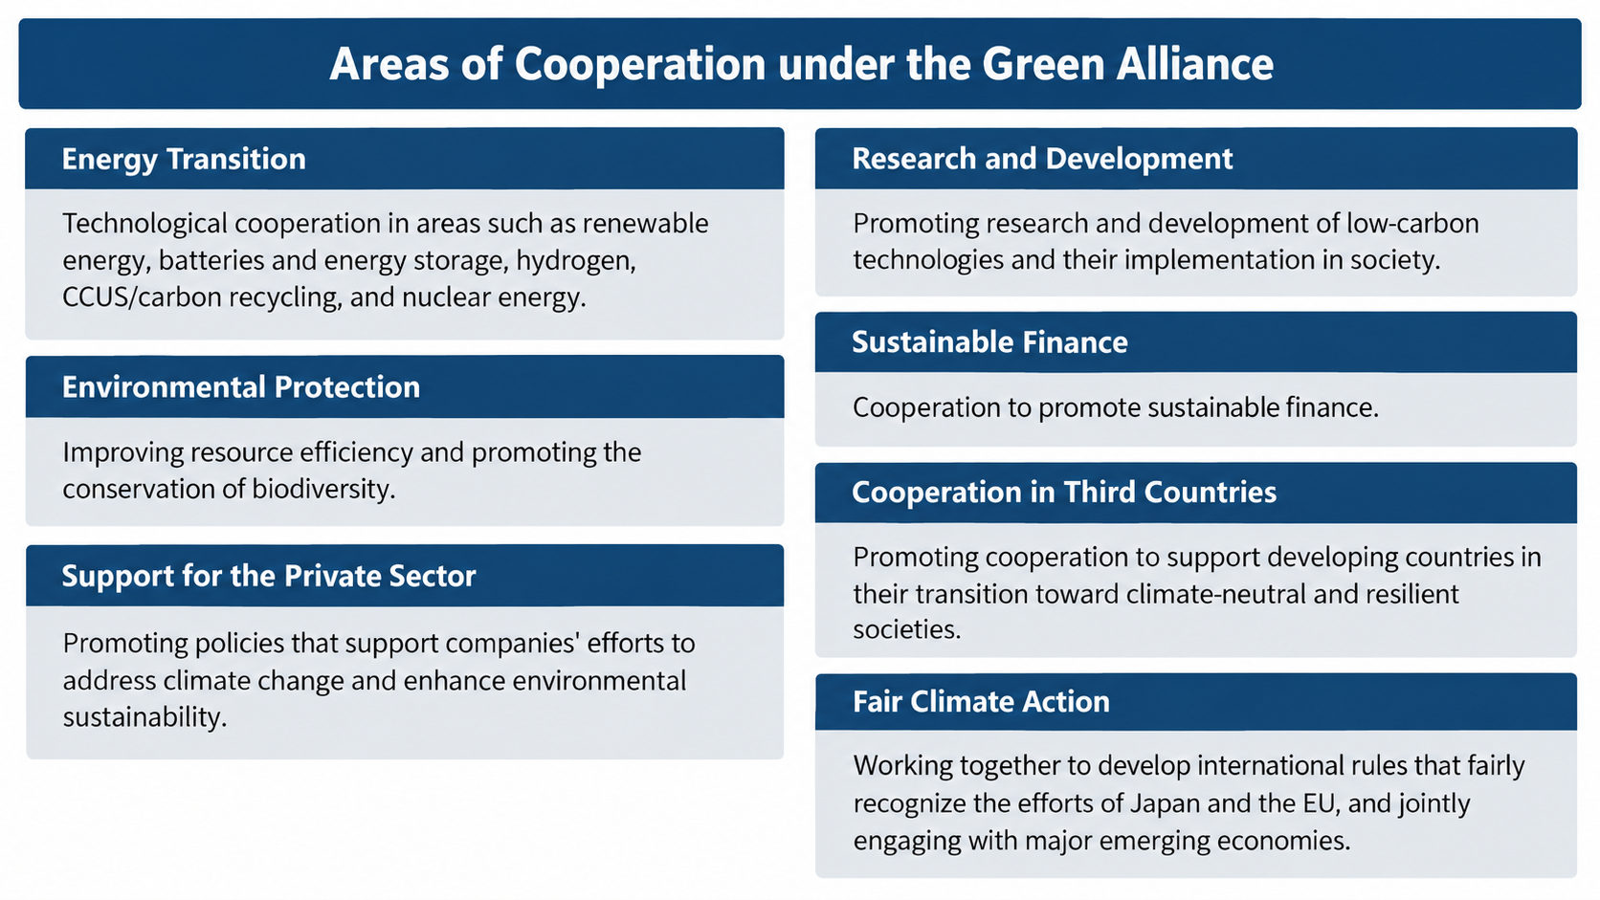
4. Japan-EU Green Alliance (May 2021)
Japan and the EU aim to achieve green growth and net-zero greenhouse gas emissions by 2050 by building an economy that is climate-neutral, biodiversity-conscious, and resource-circular. Japan and the EU will cooperate to ensure the success of this year's COP26 on climate change and COP15 on biodiversity.

Slide 15
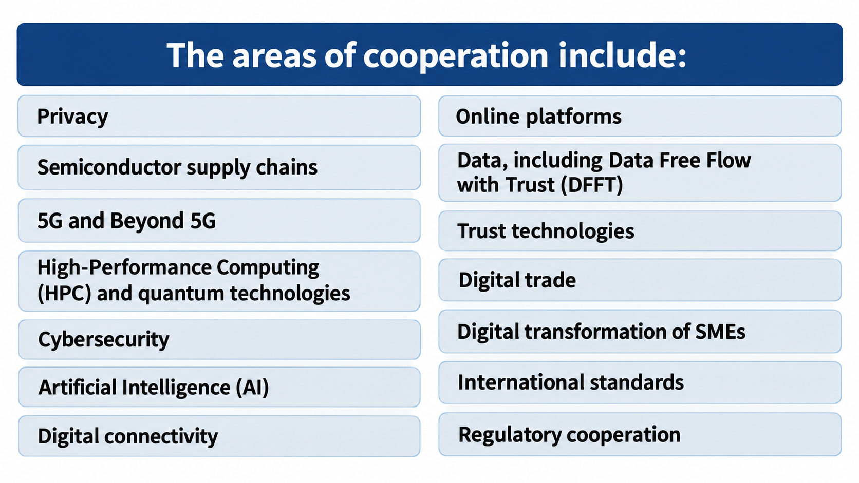
5. Japan-EU Digital Partnership (May 2022)
The areas of cooperation will be regularly reviewed and updated through the ministerial-level Japan-EU Digital Partnership Meeting.

Slide 16
EU-Japan Summit Agreement (July 2025)
6. Economic Security, Supply Chain Resilience
In the area of economic security, Japan and the EU will promote cooperation in strengthening supply chain resilience, including for critical minerals, reducing strategic dependencies, responding to economic coercion and non-market policies and practices, promoting and protecting critical and emerging technologies, and advancing cooperation in areas such as energy.

Slide 17
7. Japan-EU Competitiveness Alliance (July 2025)
Decarbonisation, Circular Economy and Energy
Supply Chain Resilience
Trade and Economic Security
Research, Innovation and Regulatory Cooperation
Space and Bio
Digital, Competition Policy and Industry Support
Defense Industry
The strengthened EU-Japan Centre for Industrial Cooperation will provide support.
EU-Japan Competitiveness Alliance | 1/2

Slide 18
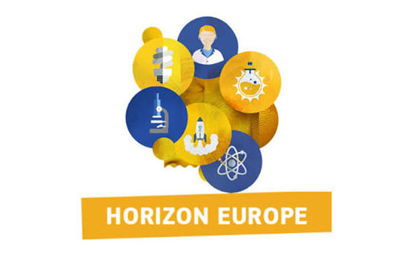
8. Associate Membership of “Horizon Europe”(July 30,2026)
The agreement allows Japanese researchers and organisations to take part in Horizon Europe on equal terms with those from EU Member States and other associated countries. They will be able to join and lead international research consortia, receive EU funding, and work alongside top research institutions to help address global challenges.
Japan's association covers Horizon Europe Pillar II, which has a budget of €52.4 billion. This pillar funds multinational research and innovation projects addressing major societal challenges related to climate, energy, health and the digital economy. Japan will also contribute financially to the programme's budget covering for the participation of Japanese entities.

Slide 19
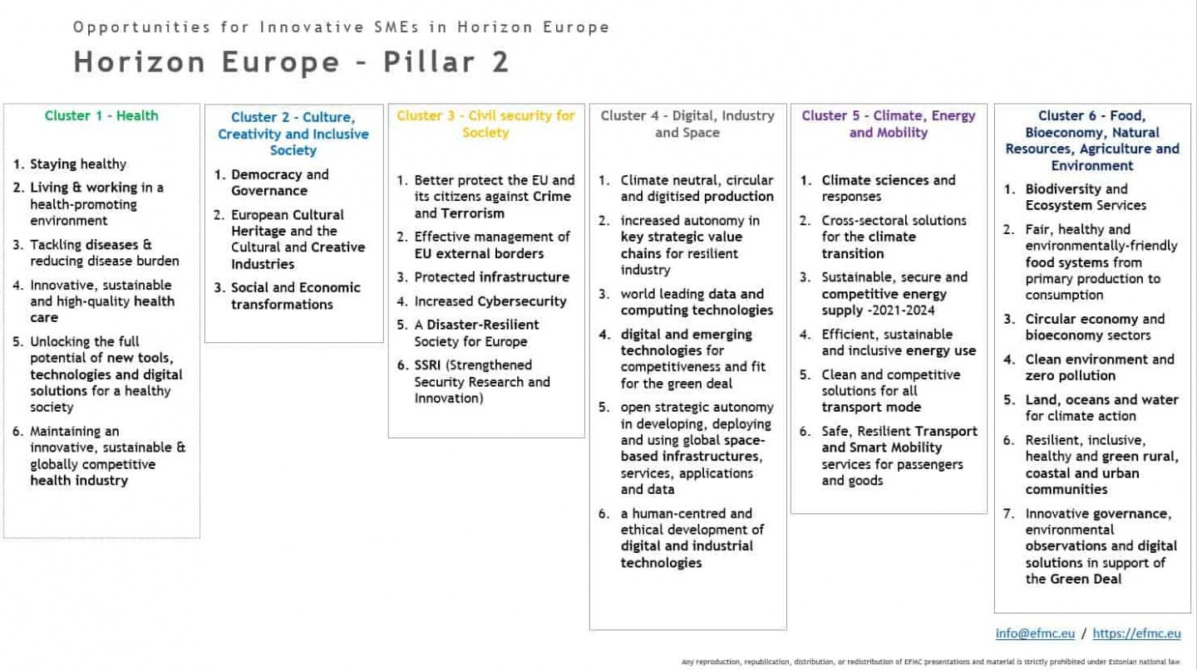

Slide 20
Past Horizon Europe Participation Examples (Japanese Companies)
Company
Area
Call name (Cluster)
Project
Shiseido Company, Limited
Bio-based materials / Circular bioeconomy
Cluster 2: Green technologies and materials for cultural heritage
Cluster 6: Circular Bio Joint Undertakings: Development of scalable, safe bio-based surfactants, with an improved sustainability profile
• GREen Endeavor in Art Restoration (GREENART)
• Bio-based sustainable SURFactants TO foster GREEN industry (SurfToGreen)
Nikko Chemicals Co., Ltd.
Bio-based materials / Circular bioeconomy
Cluster 2: Green technologies and materials for cultural heritage
Cluster 6: Circular Bio Joint Undertakings: Development of scalable, safe bio-based surfactants, with an improved sustainability profile
• GREen Endeavor in Art Restoration (GREENART)
• Bio-based sustainable SURFactants TO foster GREEN industry (SurfToGreen)
AVL Japan K.K.
AI, Data and Robotics
Cluster 4: Cognitive Computing Continuum: Intelligence and automation for more efficient data processing (AI, data and robotics partnership) (RIA)
Continuums Of Game NETs: swarm intelligence as information processing (CoGNETs)
FUTU-RE Co., Ltd.
Circular economy / Cyber-physical systems (CPS)
Cluster 4: Global call according to SRIA 2023 (RIA)
Leverage synergy by cyber-physical systems for the convergence of the eco systems mobility, infrastructure and energy n the circular economy for the Society 5.0 (Cynergy4MIE)
Kajima Corporation
Construction DX / Construction tech
CLUSTER 4: Breakthrough technologies supporting technological sovereignty in construction
Human Centered Technologies for a Safer and Greener European Construction Industry (HumanTech)
Kawada Robotics Corporation
AI, Robotics / Smart Manufacturing
CLUSTER 4: AI enhanced robotics systems for smart manufacturing (AI, Data and Robotics - Made in Europe Partnerships)
Social industrial collaborative environments integrating AI, Big Data and Robotics
for smart manufacturing (CONVERGING)
sdtech Inc.
CCAM (Connected, Cooperative and Automated Mobility)
CLUSTER 5: User-centric development of vehicle technologies and solutions to optimise the on-board experience and ensure inclusiveness (CCAM Partnership)
Autonomous self-adaptive services for TRansformational personalized inclUsiveness
and resilience in mobility (AutoTRUST)
SEMI Japan Office
Semiconductors
CLUSTER 4: Chips Joint Undertaking
Japan and EU Semiconductors: Mutual Innovation & Excellence (JASMINE)
Tokyo Metropolitan Sewerage Service Corporation
Smart Infrastructure / Infrastructure Maintenance
CLUSTER 4: Enhanced assessment, intervention and repair of civil engineering infrastructure (RIA)
AI:Liner - Data-driven sewer asset management: a path toward the resilient transformation
of Europe's sewer infrastructure (AI-Liner)
Toyo Aluminium K.K.
Next-generation photovoltaics (PV) / Clean Energy
Cluster 5: Demonstration pilot lines for alternative and innovative PV technologies
(Novel c-Si tandem, thin film tandem, bifacial, CPV, etc.)
Piloting novel cost-competitive bifacial IBC technology for vertical integrated European GW scale PV production value chain
(IBC4EU)
Cluster 1 (Health)
Cluster 2 (Culture, Creativity and Inclusive Society)
Cluster 3 (Civil Security for Society)
Cluster 4 (Digital, Industry and Space)
Cluster 5 (Climate, Energy and Mobility)
Cluster 6 (Food, Bioeconomy, Natural Resources, Agriculture and Environment)
9

Slide 21
Past Participation Examples in Horizon Europe (Companies & Universities)
Cluster 1
Cluster 2
Cluster 3
Optimising Colorectal Cancer Prevention
Through Personalised Treatment With Artificial
Intelligence
GREen ENdeavor in Art Restoration
Orchestrating next-generation mobile
modular laboratories for pandemic
monitoring preparedness
(GREENART)
(OperA)
CSGI (IT)
(ONELAB)
Universitetet I Oslo (NO)
Stichting Amsterdam UMC (NL)
Showa University
Tokyo University of Science
Tokai National Higher Education And Research
System
Nikko Chemicals Co. Ltd.
Saitama Medical University
Shiseido Co. Ltd.
Cluster 4
Cluster 5
Cluster 6
Indo-Pacific-European Hub for Digital
Partnerships: Trusted Digital Technologies for
Sustainable Well-Being
Piloting novel cost-competitive bifacial IBC
technology for vertical integrated European GW
scale PV production value chain
Marine Protected Areas Europe
(INPACE)
(IBC4EU)
(MPA Europe)
GAC (FR)
ISC Konstanz (DE)
Nord Universitet (NO)
The University of Tokyo
Toyo Aluminium K.K.
University of Ryukyu
Cluster 1 Health
Cluster 2 Culture, Creativity and Inclusive Society
Cluster 3 Civil Security for Society
Cluster 4 Digital, Industry and Space
Cluster 5 Climate, Energy and Mobility
Cluster 6 Food, Bioeconomy, Natural Resources, Agriculture and Environment
Source: Horizon Europe participation examples
9

Slide 22
Past Horizon Europe Participation Examples
(Japanese-affiliated Companies in Europe)
Company
Area
Call name (Cluster)
Project
Amount
HITACHI EUROPE SAS (FR),
HITACHI EUROPE LIMITED (UK)
Connected and automated mobility (CCAM)
Cluster 5: More powerful and reliable on-board perception and decision-making technologies addressing complex environmental conditions (CCAM Partnership)
ReliablE in-Vehicle pErception and decisIoN-making in complex environmenTal conditions (EVENTS)
€ 422 475,00 (France)
€ 0 (UK)* Before the UK became associated in 2021
NEC LABORATORIES EUROPE GMBH
6G / communications sensing
Cluster 4, 6G SNS Joint Undertakings: Wireless Communication Technologies and Signal Processing – Standardisation and Follow-up/PoCs
Advancing 6G-RAN through multi-technology, multi-sensor fusion, multi-band and multi-static perception (MultiX)
€ 836.285,42
FUJITSU TECHNOLOGY SOLUTIONS
(Belgium, Luxembourg)
Health data, AI, privacy protection
Cluster 1: Scaling up multi-party computation, data anonymisation techniques, and synthetic data generation
Privacy compliant health data as a service for AI development (PHASE IV AI)
€ 816 464,84 (Belgium)
FUJITSU TECHNOLOGY SOLUTIONS, SA
Next-generation energy systems; AI / quantum technology
Cluster 5: Emerging energy technologies for a climate neutral Europe
GRAVITational StoragE, Quantum computing, and AI for enhanced Circularity and Reliability in Clean transition-affected sector-coupled electricity grids (GRAVITEQA)
€ 216 990,00
PANASONIC EUROPE BV
Logistics decarbonisation; supply chain
Cluster 5: Scaling up logistics innovations supporting freight transport decarbonisation in an affordable way
Holistically Optimised Logistics Operations and Green Innovative Solutions for Transport Cargo Sustainably (HOLOGISTICS)
€ 301 000,00
SONY EUROPE BV (NL)
6G / next-generation communications network
Cluster 4: 6G Holistic System
A holistic flagship towards the 6G network platform and system, to inspire digital transformation, for the world to act together in meeting needs in society and ecosystems with novel 6G service (Hexa-X-II)
€ 351 742,50
MITSUBISHI ELECTRIC EUROPE BV
EV / power electronics
Cluster 5: Integration and testing of next generation post-800V electric powertrains (2ZERO Partnership)
Optimised DYnamics of high voltage powertrains: developing Sustainable Systems for Electric Vehicles (ODYSSEV)
€ 550 000,00
Cluster 1 (Health)
Cluster 2 (Culture, Creativity and Inclusive Society)
Cluster 3 (Civil Security for Society)
Cluster 4 (Digital, Industry and Space)
Cluster 5 (Climate, Energy and Mobility)
Cluster 6 (Food, Bioeconomy, Natural Resources, Agriculture and Environment)
11

Slide 23

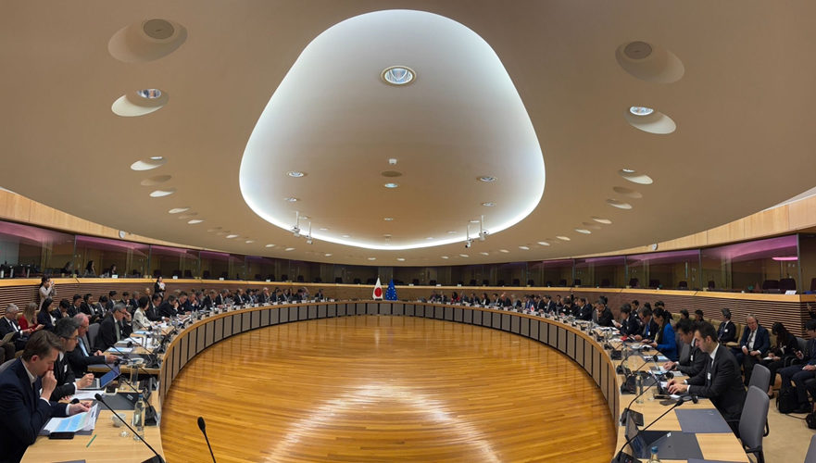
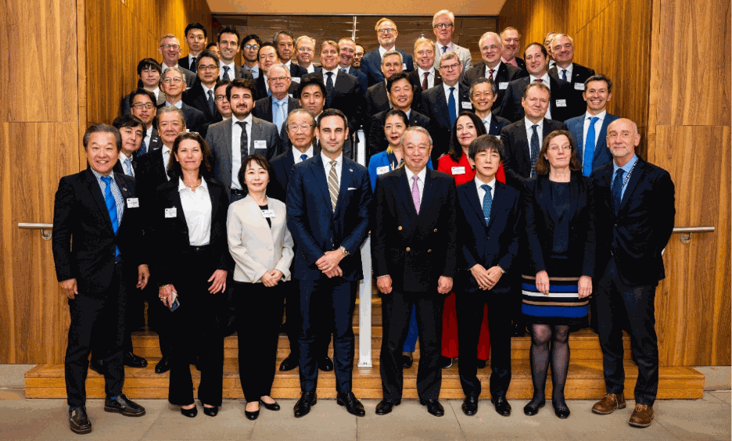
9. Japan-EU Business Roundtable（BRT)
2026 BRT Annual Meeting at the European Commission
Brussels, 16 April 2026 - the 27th annual meeting of the EU-Japan Business Round Table took place in the Schuman Room in the European Commission's Berlaymont headquarters.
It was co-chaired by Nobuhiro Endo (Executive Advisor, NEC Corporation) and Jeremy Grossas (Representative Director & President, Merck Biopharma Japan).

Slide 24

JOINT RECOMMENDATIONS of the 27th Annual Meeting
(16 April 2026, Brussels)
Global Trade
1. A rules-based world trade order ensures fair and equitable trade.
2. Global and bilateral partnerships on equal footing grow in importance.
Economic Security
1. Resilient and diversified supply chains in line with G7 principles of transparency, diversification, security, sustainability,
trustworthiness, and reliability
2. Cyber-, digital, and data security in critical infrastructure such as in energy, communications, finance
and transport
3. Technological indispensability as a key source of leverage in international trade
relations
Industrial Competitiveness
1. Innovation as the key driver of technological progress and hence competitiveness
2. Active, ambitious and targeted industrial policy vital to global competitiveness
3. Regulatory complexity as a burden for business to be addressed
4. Digitalisation and keeping up with AI to jointly advance the digitalisation of industrial value chains.

Slide 25
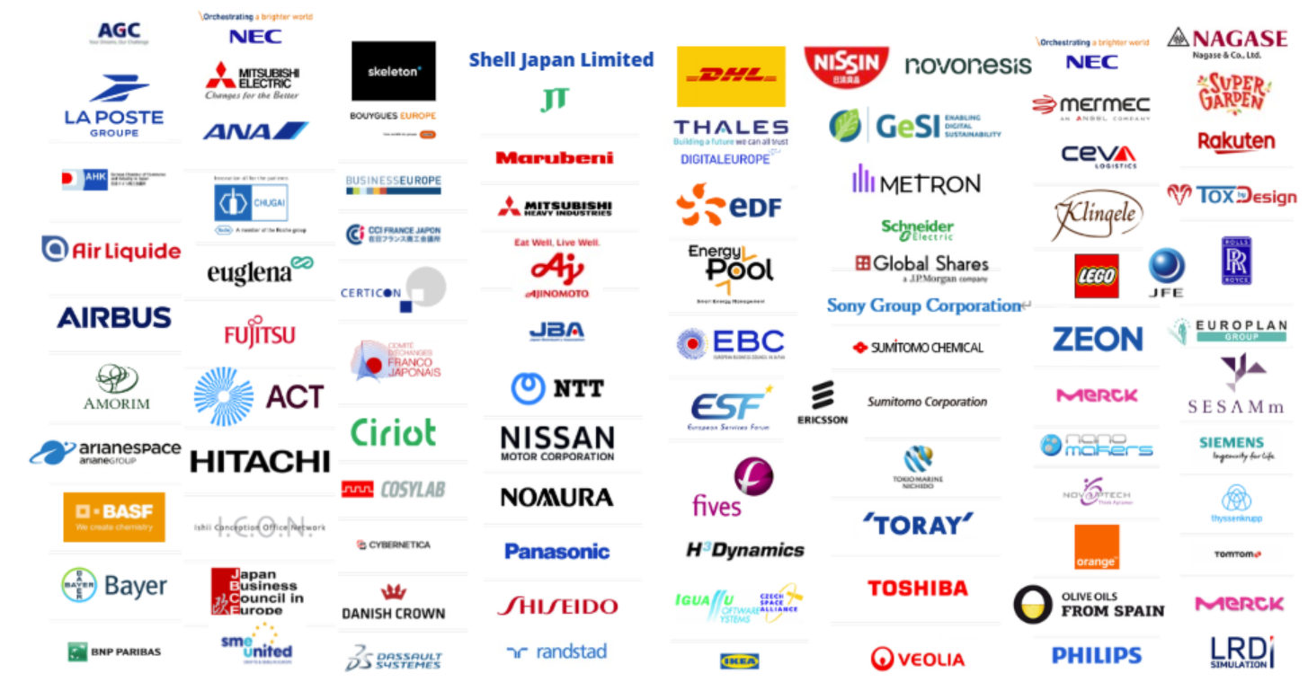
9. Japan-EU Business Roundtable（BRT)

Slide 26


10. EU-Japan Centre For Industrial Cooperation
1987 — Established jointly by the European Commission and Japan’s Ministry of Economy, Trade and Industry (METI)
2019 — EPA (Economic Partnership Agreement) and SPA (Strategic Partnership Agreement) entered into force
2020 — Became a General Incorporated Foundation
Promotes industrial cooperation between Japan and Europe through following activities:
① Policy dialogue (EU-Japan Business Round Table), policy seminars, and information dissemination
② Business matchmaking through the Enterprise Europe Network and other initiatives
③ Human resource development through internship exchanges (Vulcanus Programme)
④ Joint research and innovation through Horizon Europe
EUJC Supporting Membership Programme （Limited to companies based in Japan）

Slide 27



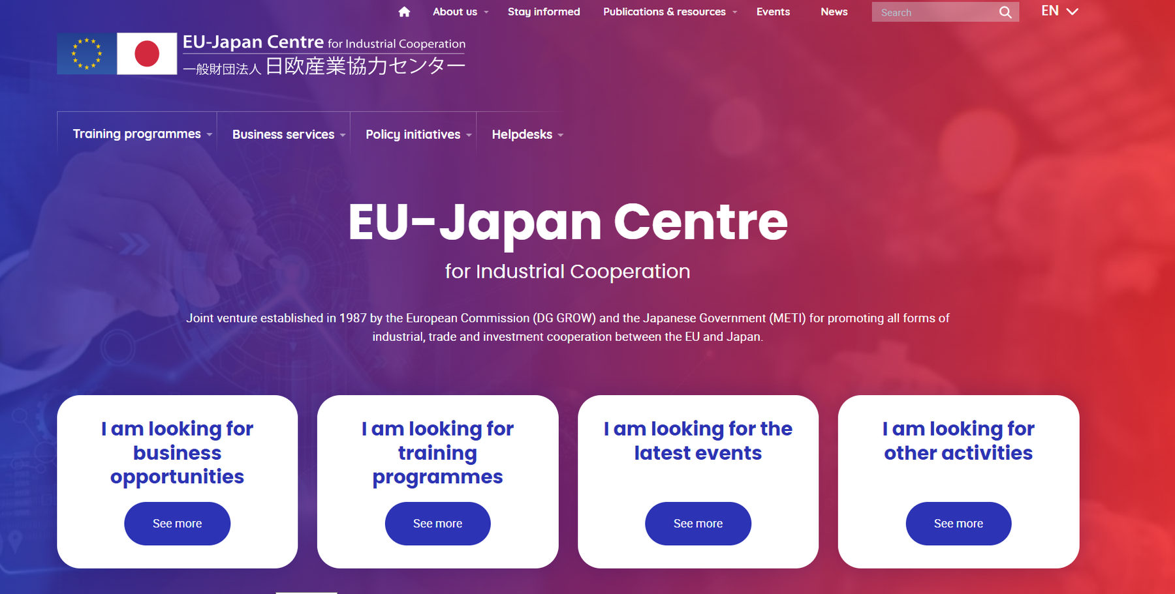
11. Conclusion: Key messages
Japan and EU can and should work together as Strategic Partners with common values in changing global environment
Closer cooperation in energy/climate, digital/AI, economic security, research/innovation, trade, competitiveness, defense industries, etc.
Utilize the EUJC
https://www.eu-japan.eu

